Slide 1
History of Animation
Second Cycle Degree in Theatre, Film, Television and Media Studies
Academic Year 2018-2019
Lesson 7

Slide 2
The Beginning of Animated Cinema
«Animation has bred a myth about its own origins that goes, according to the film historian’s lore, like this: Animation was virtually unknown until 1907. It was then that L’Hôtel hanté opened in Paris. The public response to this first animated film was so strong that all the French producers racked their brains trying to figure out the tricks that made objects move by themselves. After considerable difficulty, the secret was discovered and the history of cartoons could begin».
Donal Crafton, Before Mickey. The Animated Film 1898-1928, The University of Chicago Press, Chicago, 1993, p. 13.

Slide 3
The Beginning of Animated Cinema
The Haunted Hotel; or, The Strange Adventures of a Traveler
(Vitagraph of America, James Stuart Blackton, 1907)

Slide 4
The Beginning of Animated Cinema
Why was The Haunted Hotel a success?
The theme was not new. It was quite a common plot for stage acts and early films.
Donald Crafton lists at least seven films with a similar story among 1896 and 1900.
Some of them were by Georges Méliès, pioneer and master of “trick” films.

Slide 5
The Beginning of Animated Cinema
L’Auberge ensorcelée (Georges Méliès, 1897)

Slide 6
The Beginning of Animated Cinema
L’Auberge du bon repos (Georges Méliès, 1903)

Slide 7
The Beginning of Animated Cinema
… After Blackton’s film, the theme was even revived.
Its most relevant iteration was created by Spaniard Segundo de Chomón (1871-1929).
Later a director and a professional of special effects for Pathé trickfilms and for Itala Film in Turin (since 1912: he authored the special effects of Giovanni Pastrone’s Cabiria, 1914), Chomón tried to improve Blackton’s idea with El hotel eléctrico (1908).

Slide 8
The Beginning of Animated Cinema
El hotel eléctrico (Segundo de Chomón, 1908)

Slide 9
The Beginning of Animated Cinema
James Stuart Blackton
The Haunted Hotel was not even Blackton’s first animation.
Born in Sheffield (UK) in 1875, Blackton moved to the USA at the age of ten. He interviewed Thomas Alva Edison as a teenage journalist; as he confessed to an aptitude for drawing, he was asked to draw Edison’s portrait while a camera filmed the scene. The episode started Blackton’s career in cinema.
Blackton had direct experience with “chalk talks” or “lightning sketches”, a quite common kind of vaudeville act. He translated it into film, maybe realizing that drawings could be animated by single-framing techniques, just like objects.

Slide 10
The Beginning of Animated Cinema
James Stuart Blackton
The enchanted drawing (James Stuart Blackton, 1900)

Slide 11
The Beginning of Animated Cinema
James Stuart Blackton
Humorous Phases of Funny Faces (James Stuart Blackton, 1906)

Slide 12
The Beginning of Animated Cinema
James Stuart Blackton
Lighting Sketch (James Stuart Blackton, 1907)

Slide 13
The Beginning of Animated Cinema
James Stuart Blackton
The Haunted Hotel was such a sensational film partly because of some clever and hyperbolic advertising, but more importantly because some of its scenes displayed stand-alone object animation. Sometimes, animation stopped being a mere “trick” and became an independent expressive device: it was no more just a funny “disturbance” to live-action, but something of equal importance.
«The Vitagraph film The Haunted Hotel was a sensation and rightly so. Abandoning all the tricks of the movies, they had contrived entirely new and totally unexpected combinations of techniques. As we watched, the sharpest, most attentive eye was unable to detect any wires. One had to be informed of the process».
Victorin Jasset, 1911, quoted in Crafton, op. cit., p. 16.

Slide 14
The Beginning of Animated Cinema
As argued by Giannalberto Bendazzi (who follows C. W. Ceram [Kurt Wilhelm Marek]), a history of cinema animation should start when the animation process is no more a mere series of techniques, but it becomes a foundation for creativity and it gives rise to a new productive stage.
The first requirement was surely met by The Haunted Hotel, and even earlier films complied with it (Matches: An Appeal, by Arthur Melbourne Cooper, 1899).

Slide 15
The Beginning of Animated Cinema
Matches: An Appeal (Arthur Melbourne Cooper, 1899)

Slide 16
The Beginning of Animated Cinema
As to find evidence of the second requirement (rise of a new productive stage), however, it is necessary to wait until 1908: the year when, according to legend, a filmmaker finally discovered the trick behind Blackton’s The Haunted Hotel.
That man was the eclectic artist Émile Courtet, also known as Émile Cohl (1857-1938), who in 1907, at 50, joined Gaumont to begin his career in cinema.

Slide 17
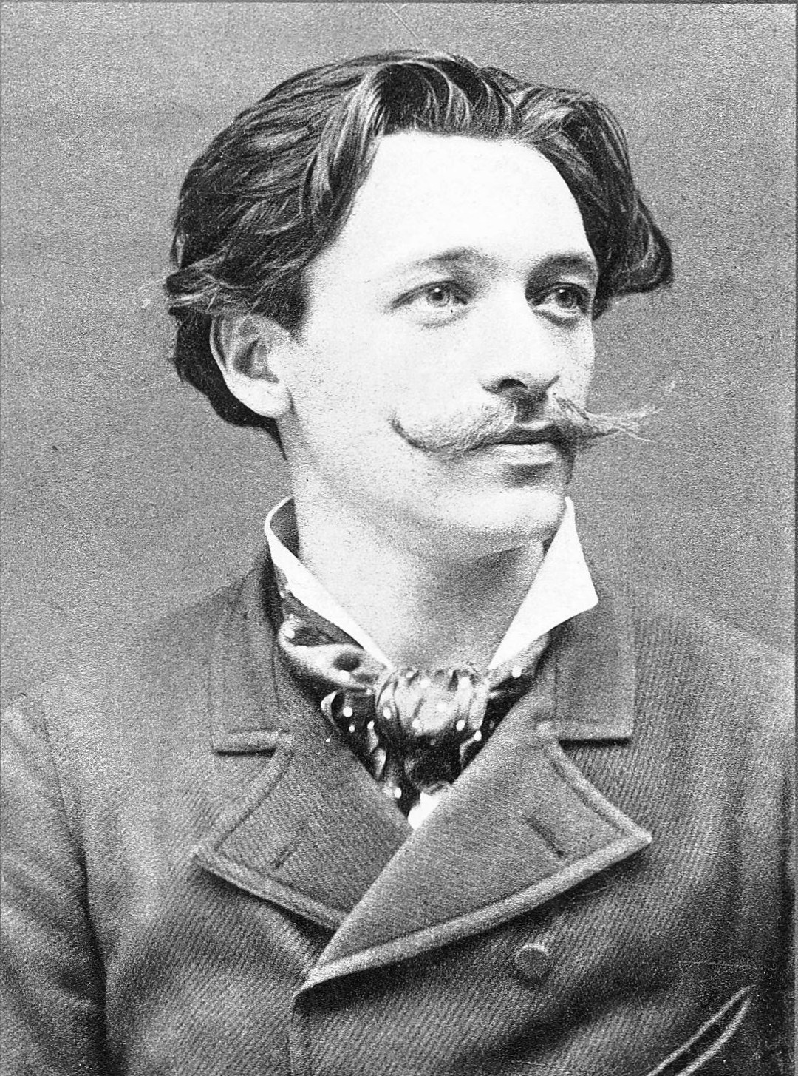
The Beginning of Animated Cinema
Émile Cohl

Slide 18
The Beginning of Animated Cinema
Émile Cohl
Èmile Cohl
Born in 1857 from a rubber salesman and a linen seamstress.
1867: Cohl discovers the works of André Gill, the best-known caricaturist of the day.
1878: he changes his surname from Courtet to Cohl and becomes assistant to André Gill. He learns a style of caricature whose trademark was a large head atop a small puppet-like body.
1879: editor of L’Hydropathe, satiric journal of the artistic circle Les Hydropathes, created in 1878 by Èmile Goudeau.
1882: the Hydropathes are disbanded, Cohl joins the Incoherents, founded by Jules Lévy.
1883: editor in chief at La Nouvelle Lune.
1885: death of André Gill.
1888: end of the Incoherents.

Slide 19
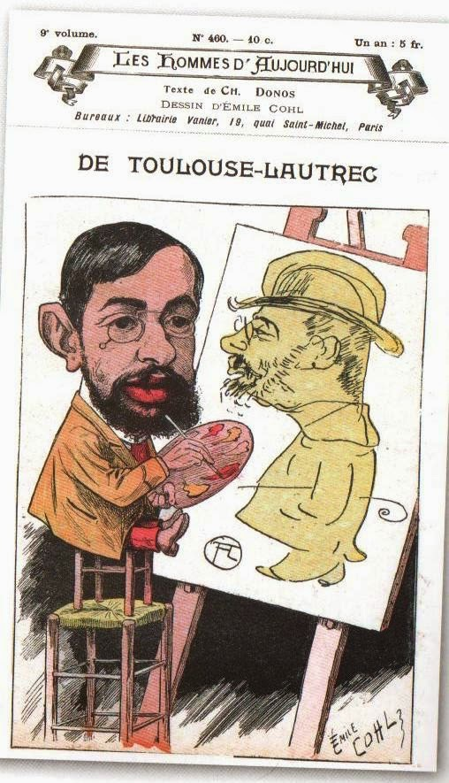
The Beginning of Animated Cinema
Émile Cohl
Les hommes d’aujourd’hui,
no. 460, 1897

Slide 20
The Beginning of Animated Cinema
Émile Cohl
«Cohl was like a chameleon of many colours. He worked as a caricaturist for several magazines, such as Les hommes d’aujourd’hui, to which he supplied caricatures of Verlaine and Toulouse-Lautrec. (In 1894, that same magazine confirmed Cohl’s vast notoriety by dedicating to him a cover caricature signed by Uzès). In the 1880s, Cohl turned successfully to photography. His light comedies were performed in the theatres of the boulevards and, last but not least of his numerous hobbies, he was interested in puzzles and magic tricks».
Giannalberto Bendazzi, Cartoons. One Hundred Years of Cinema Animation, John Libbey, London, 194, p. 9.

Slide 21
The Beginning of Animated Cinema
Émile Cohl
«During the winter [of 1908], Cohl had been walking in Monmartre when he noticed a poster for a film that apparently stole an idea from one of his comic strips. That this was a common practice at the time did little to assuage his temper, and he stalked over to the Gaumont studios to demand compensation. There he was met by Louis Feuillade, the “artistic director” of the company and the future director of Fantomas. Feuillade, no doubt secretly amused by the old man’s wrath, offered him a job writing scenarios. […] Cohl took the offer seriously and wrote several féeries. […] While he was writing scenarios, Cohl was also working on the Fantasmagorie drawings. The cartoon was completed in July and released in August, and was an international success. Cohl’s subsequent work pleased Léon Gaumont, and in January 1909 […] he was made a full-time salaried director. By the time he left the studio in 1910, Cohl would complete 77 films».
Donald Crafton, Before Mickey. The Animated Film 1898-1928, The Chicago University Press, Chicago, 1993, pp. 65-66.

Slide 22
The Beginning of Animated Cinema
Émile Cohl
Fantasmagorie (Émile Cohl, 1908)

Slide 23
The Beginning of Animated Cinema
Émile Cohl
Does Fantasmagorie reference any “genre” of early cinema? Is it just a féerie?
At the beginning it foregrounds the author, just like in Blackton’s lighting sketches.
But then, the author “disappears”.
The attraction is no more the display of a magician’s “trick”. Animation is no more a matter of making things appear or disappear, or of moving objects around. The motion itself, instead, takes center stage, by causing seamless metamorphoses. The lines are simple, the characters are abstract and naive; but that does not matter, as Cohl is more interested in motion than in what is moving.
Moreover: with Cohl, animation starts to define its own visual grammar.

Slide 24
The Beginning of Animated Cinema
Émile Cohl
Clair de lune espagnol (Émile Cohl, 1909)

Slide 25
The Beginning of Animated Cinema
Émile Cohl
Le retapeur de cervelles (Émile Cohl, 1910)

Slide 26
The Beginning of Animated Cinema
Émile Cohl
Le cheveu délateur (Émile Cohl, 1911)

Slide 27
The Beginning of Animated Cinema
Émile Cohl
In 1910, after an unsuccessful request for a raise, Cohl left Gaumont for Pathé. But he was pressured to do live-action and trick films. Only one of his eigth Pathé films survives – Le Retapeur de cervelles.
Through his friend and technical mentor Étienne Arnaud, Cohl was able to find a new job at the Eclair Company Studio in Fort Lee, New Jersey, USA.
From 1912 to 1914 Cohl worked on the series “The Newlyweds”, based on a newspaper comic strip by George McManus.
It was in an advertisement for “The Newlyweds” that the phrase “animated cartoons” was first used to describe this new genre.
A fire destroyed all of Cohl’s American works in 1914. A fire, indirectly, marked also the end of Cohl’s existence: in 1937, poor and forgotten, he knocked over an oil lamp. He died of pneumonia in a charity hospital, on January 20, 1938.

Slide 28
The Beginning of Animated Cinema
Émile Cohl
Cohl “created” animation also because with his work, for the first time, he defined what is an animator.
«He became the first of many similar individuals who would eventually populate animation studios everywhere. Among the distinctive features of this personality profile are a background in journalism, a compulsion to sketch, “workaholic” tendencies, and a well-developed but idiosyncratic sense of humor. Cohl was the first to bring to the cinema the necessary qualities of intellect, imagination, patience, and the obsessive love of drawing that would mark other great animators».
Crafton, op. cit., p. 60.

Slide 29
The Beginning of Animated Cinema
Émile Cohl

Slide 30
Suggested readings
Donald Crafton, “The Secret of the Haunted Hotel”, in Before Mickey. The Animated Film 1898-1928, The University of Chicago Press, Chicago, 1993, pp. 13-33.
Id., “The First Animator: Emile Cohl”, ivi, pp. 58-88.
Giannalberto Bendazzi, Animation. A World History. 3 voll., Waltham, Massachusetts: Focal Press, 2015. Vol. I, pp. 35-43: “The Silent Pioneers (1908-1928)” (to study from –and including- the section “Winsor McCay”).

