Slide 1
Dealing with discrimination and harassment at Unipd
Instruments and measures

Slide 2
Consent –a cup of tea
https://www.google.com/search?q=consent+video+tea&oq=consent+video&aqs=chrome.1.69i57j0l5.11320j0j8&sourceid=chrome&ie=UTF-8

Slide 3
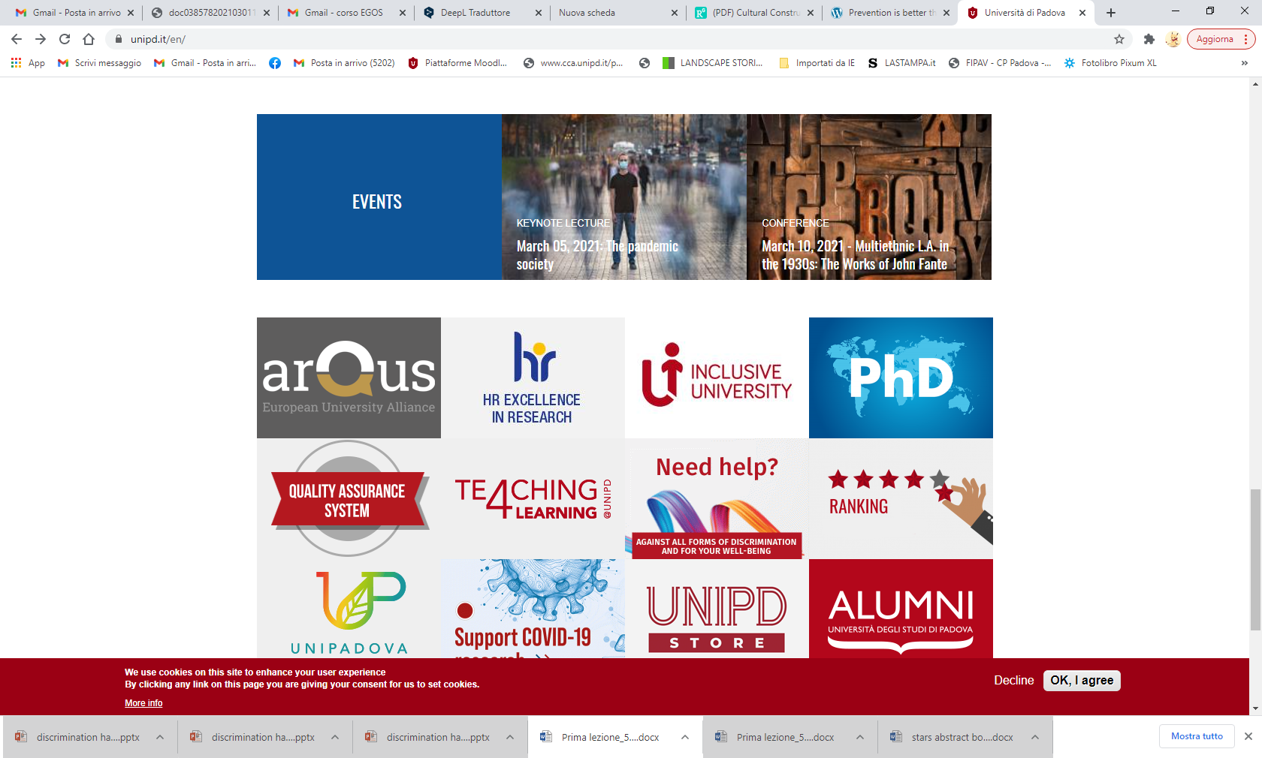
Need help?

Slide 4
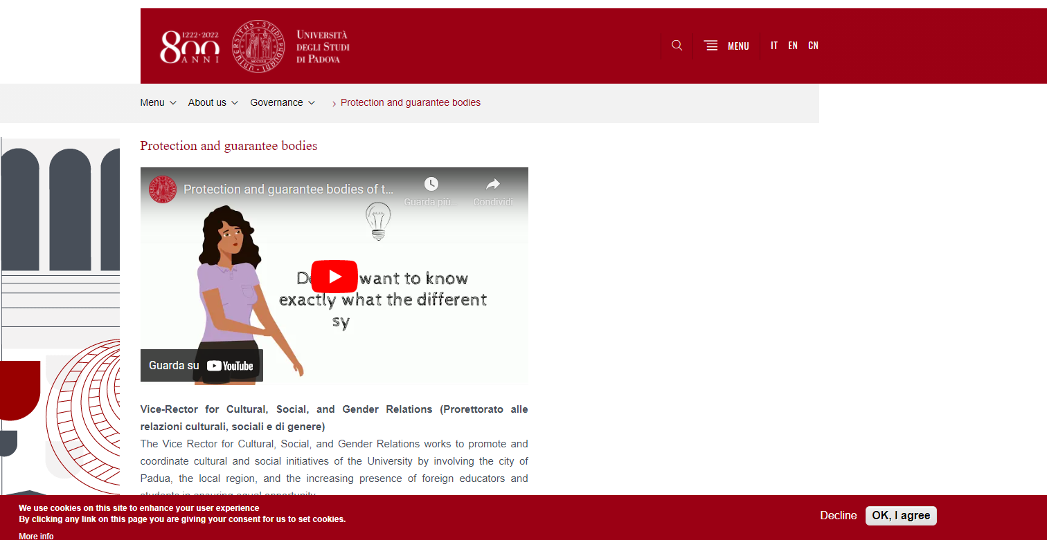
How UNIPD can help you
https://www.unipd.it/en/protection-guarantee-bodies
https://www.unipd.it/en/node/8426.

Slide 5
How UNIPD can help you
Anti discrimination committee
https://www.unipd.it/cug
https://www.unipd.it/consigliera-fiducia
Counsellor (Anti discrimination and harassment)

Slide 6
Code of Conduct at UNIPD
Code of conduct against harassment and mobbing (in italian)
https://www.unipd.it/sites/unipd.it/files/2017/codice_condotta.pdf

