Slide 1
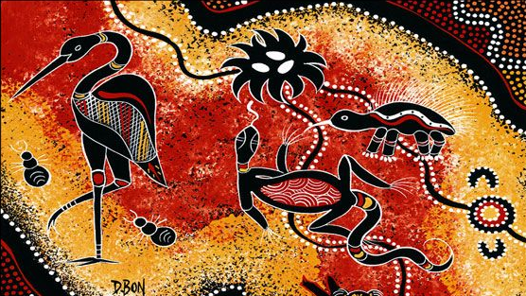
“INDIGENOUS ART AS A LANGUAGE IN EDUCATION:
CHALLENGING EUROCENTRIC IDEOLOGIES OF LANGUAGE AND CURRICULUM”
DECOLONIAL STRATEGIES (MOD. B)
MsC “European and Global Studies”
Based on: Kathy A. Mills & Katherine Doyle (2019). Visual arts: a multimodal language for Indigenous education, Language and Education, 336, 521-543
Lucía Félix Prieto

Slide 2
INTRODUCTION. MAIN CONCEPTS
(A) MULTIMODALITY
“Multimodal literacy describes communication practices that use two or more modes of meaning”.
“Specific examples of modes from a social semiotic perspective include written language, speech, gesture, movement, music, mathematical and scientific notation, attire, images, and the design of objects and environments”.
Mills, K.A., & Unsworth, L. (2017)
Multi-modal pedagogy
Indigenous knowledge = multimodal → Visual artistic representations, movement, music

Slide 3
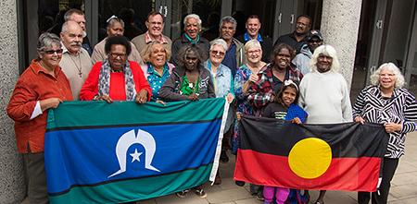
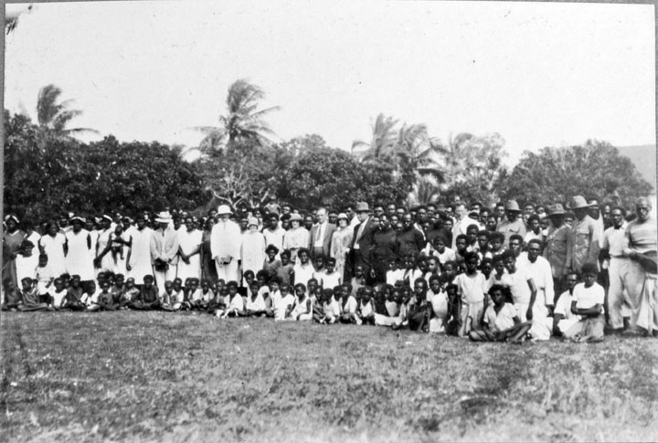
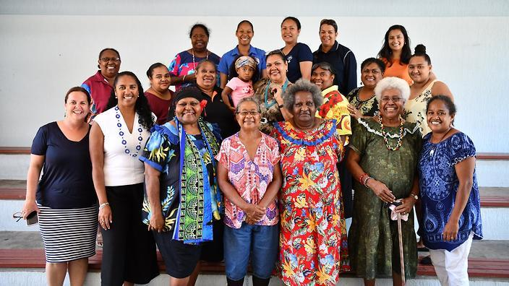
INDIGENOUS
Aboriginal and Torres Strait Islander People of Australia, or the Original People or First People of Australia
🗺️ Map of indigenous Australia
Mills, K.A., & Doyle, K. (2019)

Slide 4
INTRODUCTION. MAIN CONCEPTS
(B) INDIGENOUS (TRADITIONAL) KNOWLEDGE
“Indigenous traditional knowledge generally means traditional practices and culture and the knowledge of plants and animals and of their methods of propagation. It includes: expressions of cultural values, beliefs, rituals and community laws, knowledge regarding land and ecosystem management”
“Indigenous peoples have developed a close and unique connection with the lands and environments in which they live. They have established distinct systems of knowledge, innovation and practices relating to the uses and management of biological diversity on these lands and environments”.
Calma, T. (2008). Aboriginal and Torres Strait Islander, Social Justice Commissioner
→ Importance of multimodality and visual art expressions
“Visual imagery is one of the ways through which Indigenous students work, learn, and express knowledge” (Yunkaporta 2009a, 2009b; in Mills, K.A., & Doyle, K., 2019)

Slide 5
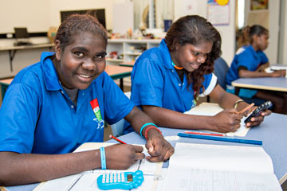
CASE STUDY. INDIGENOUS EDUCATION IN AUSTRALIA
INDIGENOUS STUDENTS IN THE INDEPENDENT SCHOOLS SECTOR, 2020
Indigenous students enrolments | 15,395
Independent schools with 50%+ Indigenous enrolment | 44
Independent schools with Indigenous enrolments | 929
Independent boarding schools with Indigenous enrolments | 140
- Independent Schools Australia, 2020
“As a group, Indigenous students face significant barriers to educational achievement. In order to overcome these barriers many Indigenous parents are enrolling their children in Independent schools”
“Independent schools that serve significant or solely Indigenous student populations often have very limited capacity to raise private income through fees and fundraising; in many cases this ability is non-existent. These schools rely heavily on government assistance to maintain their operations”

Slide 6
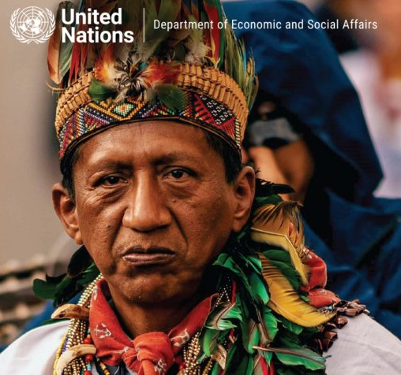
CASE STUDY. INDIGENOUS EDUCATION IN AUSTRALIA
PROBLEM → “WESTERN PRIVILEGED FORMS OF LITERACY”- Mills, K.A., & Doyle, K. (2019)
Lack of respect and resources cause critical education gap. Too often, education systems do not respect indigenous peoples’ diverse cultures. There are too few teachers who speak their languages and their schools often lack basic material. (...)
Loss of identity, caught in no man’s land. When indigenous school children are introduced only to the national discourse at the expense of their native discourse, they are in danger of losing part of their identity, their connection with their parents and predecessors and, ultimately, of being caught in a no man’s land whereby they lose an important aspect of their identity while not fully becoming a part of the dominant national society.
Education often irrelevant. Indigenous students frequently find that the education they are offered by the state promotes individualism and a competitive atmosphere, rather than communal ways of life and cooperation. They are not taught relevant survival and work skills suitable for indigenous economies, and they often return to their communities with a formal education that is irrelevant or unsuitable for their needs. (...)
Full report

Slide 7
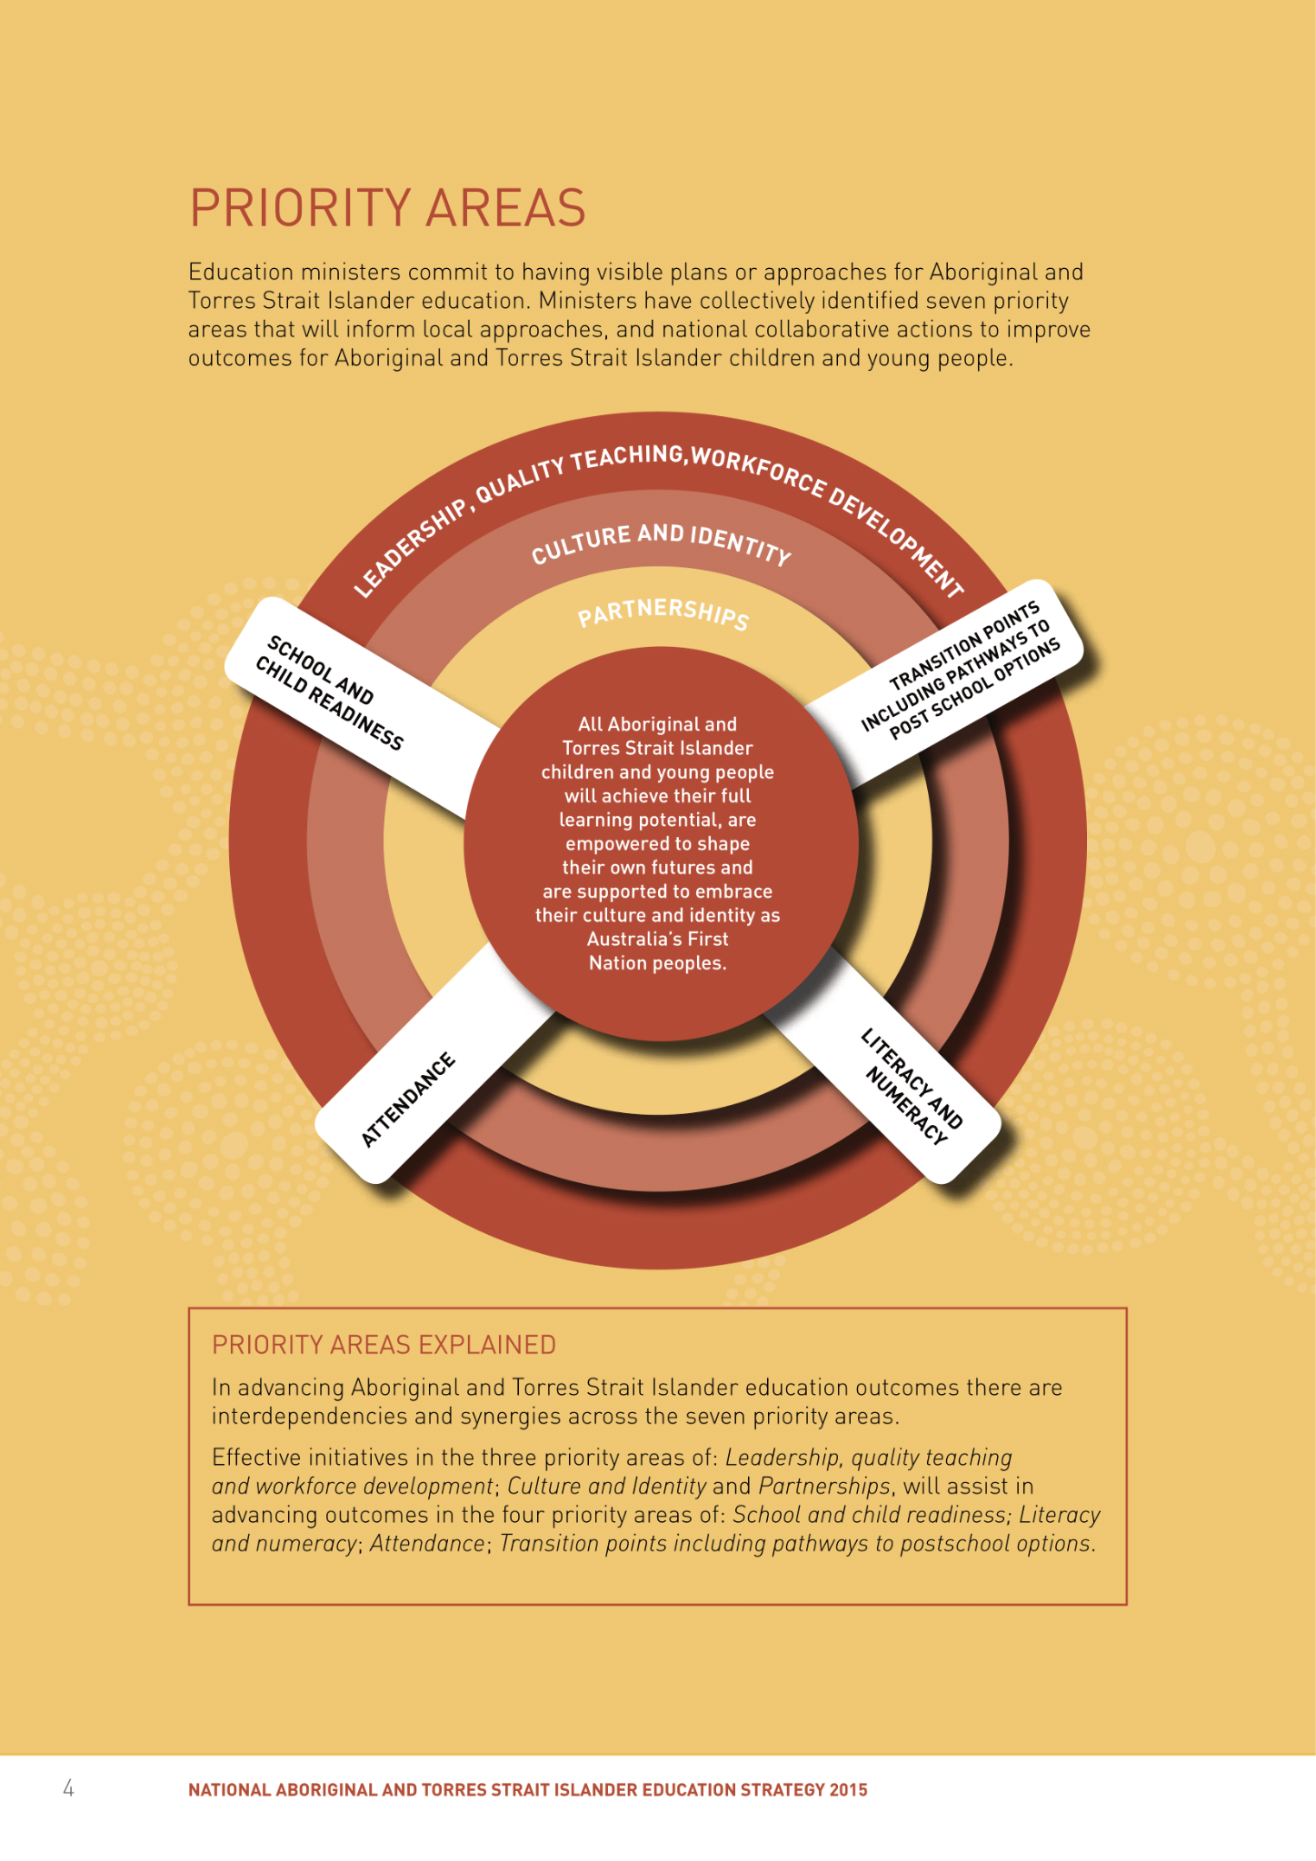
Original document

Slide 8
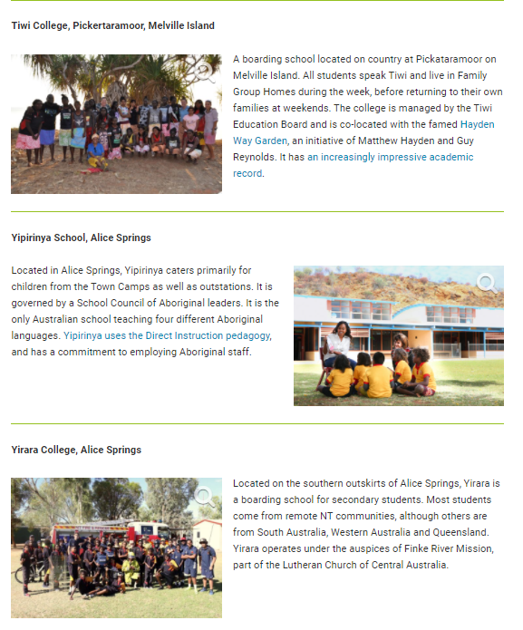
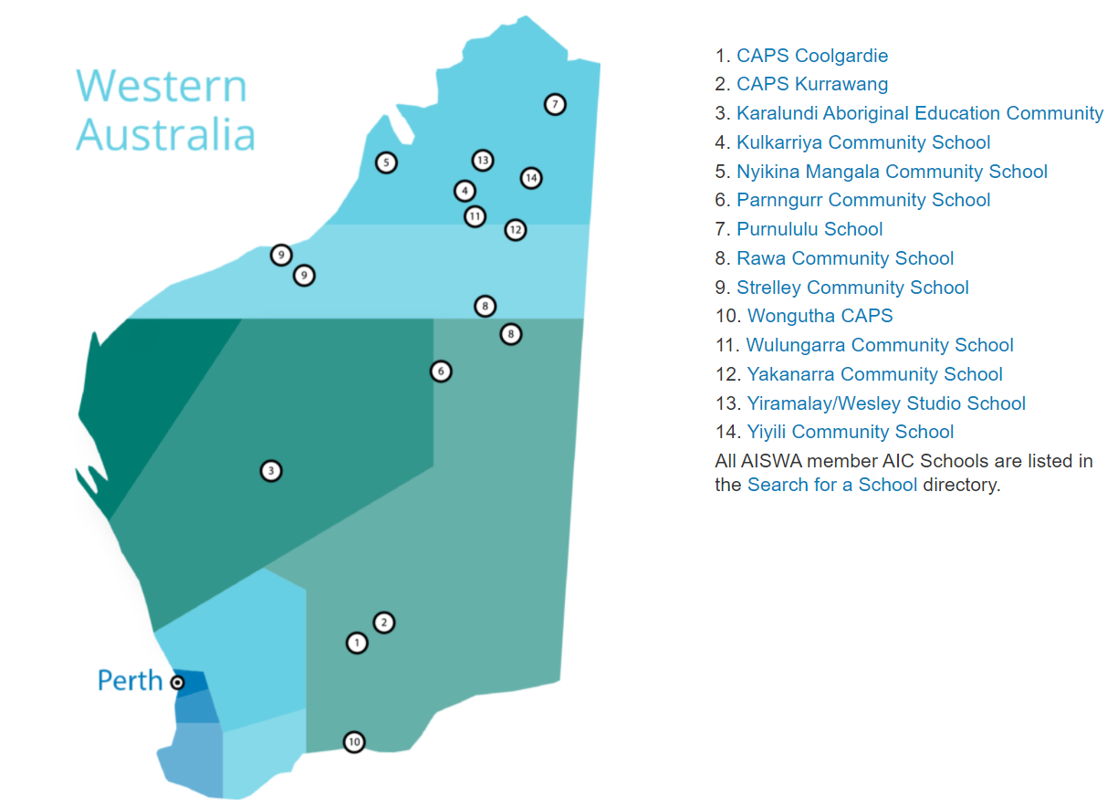
TOWARDS A SOLUTION? → ABORIGINAL INDEPENDENT COMMUNITY SCHOOLS (AICS)
“The success story of these schools is in their capacity to deliver mainstream education in an environment where learning is nurtured by cultural identity, traditional language in many instances, and a sense of belonging to place”.
Association of Independent Schools of Western Australia
Western AUS: 14
Northern AUS: 6

Slide 9
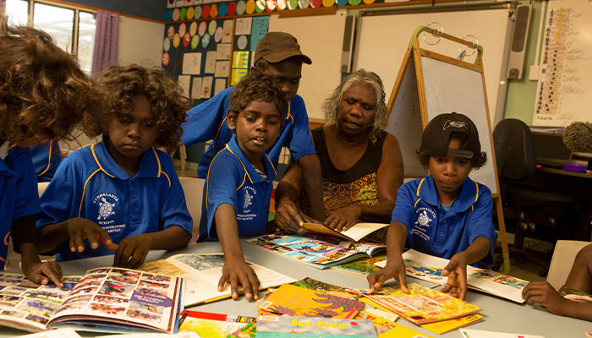
TOWARDS A SOLUTION?
ABORIGINAL INDEPENDENT COMMUNITY SCHOOLS (AICS)
PROBLEM (AGAIN) → “WESTERN PRIVILEGED FORMS OF LITERACY”- Mills, K.A., & Doyle, K. (2019)
“Visual arts and other modes and media of communication are vital to Indigenous People, yet multimodal forms of representation, such as those prioritised in the arts, are often poorly understood and excluded from Indigenous education”.
Kathy A. Mills & Katherine Doyle (2019)

Slide 10
AN ALTERNATIVE. VISUAL ARTS AND MULTIMODAL REPRESENTATION IN INDIGENOUS SCHOOLS
Kathy A. Mills & Katherine Doyle (2019). Visual arts: a multimodal language for Indigenous education, Language and Education, 336, 521-543
THE ARTICLE - RESEARCH:
Participatory research (1 year) + semi-structured interviews
In an elementary classrooms in an Indigenous independent, suburban school in Queensland, Australia -> Practices under the care of Elders*, by students who belonged to the Yuggera, Jagera, and Ugarapul language regions of South East Queensland, and identified as First Nations People
The research report was “peer-reviewed by an Indigenous Elder to strengthen the authenticity of the Indigenous perspectives and to respect the ownership of Indigenous knowledge”

Slide 11
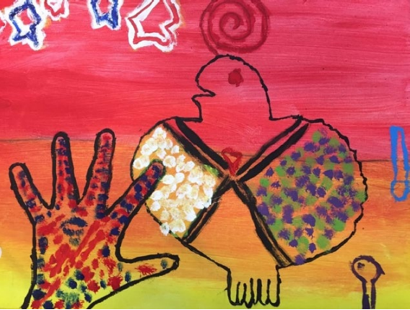
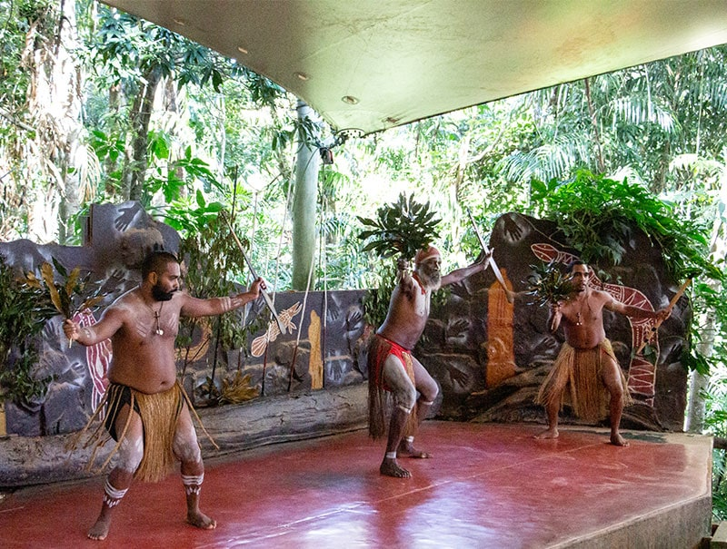
(A) DEEPENING INTO THE METHODS
Multimodal and arts-based literacy practices
“Indigenous elementary students were taught by Indigenous community leaders to engage in visual arts through paintings and other forms of artistic representation (e.g. dances, rap video). These artistic expressions were coherent with Indigenous ways of learning and communicating”.
Mills, K. A., & Doyle, K. (2019)
Individual tempera paintings of the land
Weekly dance classes
Whole class rap video performance

Slide 12
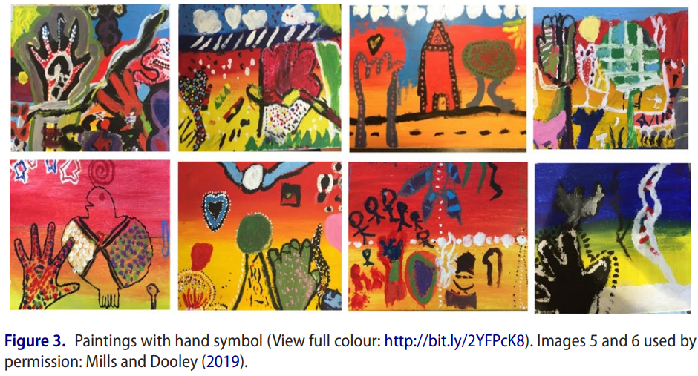
Individual tempera paintings of the land

Slide 13
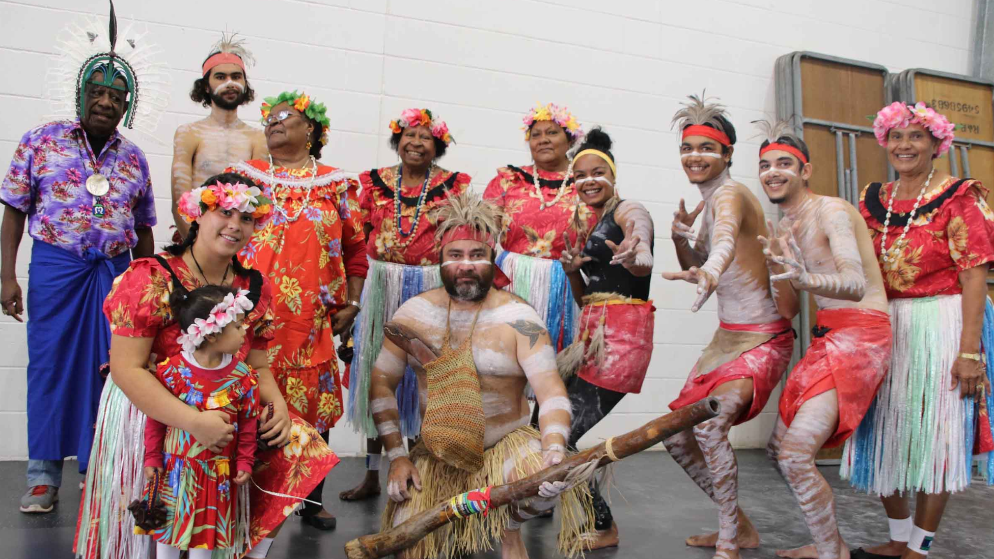
Weekly dance classes
“On a weekly basis, Aboriginal and Torres Strait Islander dance groups taught classes in the school, formally observed with the Year 3 class. Dance is central to Indigenous identity and place (Country), enabling dancers to resonate and connect with tribal lands (Lawlor 1991)”.
Mills, K. A., & Doyle, K. (2019)

Slide 14
Whole class rap video performance

Slide 15
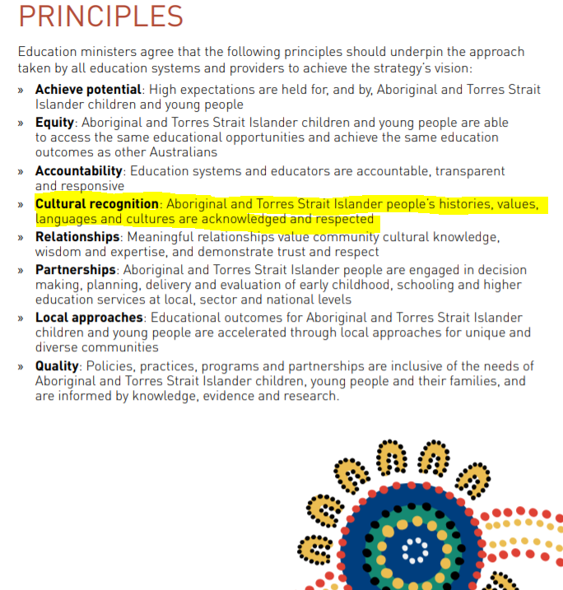
(B) WHY?
Shall these methods be included
Original document

Slide 16
(B) WHY? Shall these methods be included
“This pedagogy embraced Indigenous ways of learning and working with the cycles and patterns of nature and the environment”.
“Visual art and its associated oral storytelling are vital multimodal representational resources for transgenerational knowledge forms valued by Indigenous Peoples”.
“The multidimensional viewing of the paintings enhanced the visibility of the transgenerational flows of Indigenous knowledge—from the Ancestors, to the Aunties, and to the children”.
“A curriculum that offers learners an understanding of Aboriginal and Torres Strait Islander world views or ‘knowledge frameworks’ enables students (and teachers) to gain a greater appreciation of the diversity of Indigenous peoples, and the differences and similarities between these and their own experiences and world views”.
Mills, K.A., & Doyle, K. (2019)
Queensland Government (2019)

Slide 17
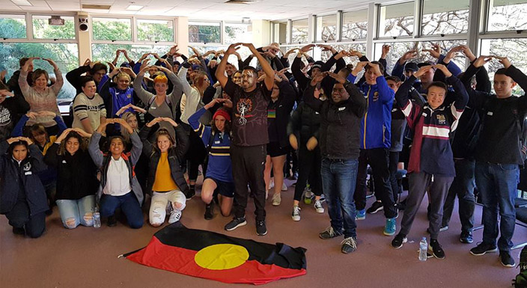
(C) KEY RECOMMENDATIONS
→ FOR WESTERN EDUCATORS
The modification of Eurocentric views of communication to recognise the integral role of art as language within Indigenous cultures
Understanding the power of visual art in Indigenous ways of learning, doing, and knowing
Realisation of the insightful meanings of Indigenous representation
Mills, K.A., & Doyle, K. (2019)

Slide 18
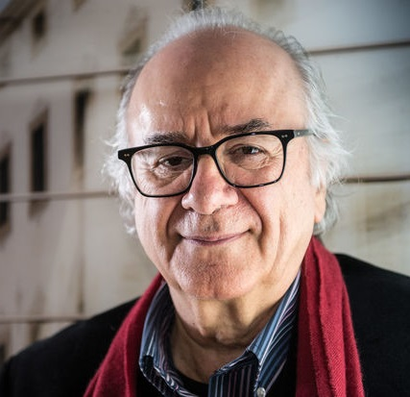
PERSONAL REFLECTIONS
De Sousa Santos, B. (2014). Epistemologies of the South: Justice against epistemicide
Strongly in favour of this multimodal pedagogy, because…
✔️ It facilitates their learning process, starting from their prior knowledge and their way of conceiving the world and, especially, pedagogy, by implementing these methods by "original pedagogues" (people of the tribe, referents from early ages)
Constructivist Pedagogy - Jean Piaget
✔️ By using their previous knowledge to express themselves and communicate, they develop their artistic and communicative skills much more easily.
Aligned with the post-abyssal thinking proposed by B. de Sousa Santos (2014)
Ecologies of knowledge - Favourising the dialogue with other knowledges: Indigenous knowledge, by identifying the context in which it operates: Indigenous communities → “Equality of opportunities”
Even possibly beneficial for nowadays society → Climate crisis, environmental protection → IMP. of Indigenous property
“The ecology of knowledges confronts the logic of the monoculture of scientific knowledge and rigor by identifying other knowledges and criteria of rigor and validity that operate credibly in social practices pronounced non-existent by metonymic reason.”
“It consists of granting ‘equality of opportunity’ to the different kinds of knowledge involved in ever broader epistemological arguments with a view to maximizing their respective contributions toward building “another possible world” that is to say, a more just and democratic society, as well as one more balanced in its relations with nature”.

Slide 19
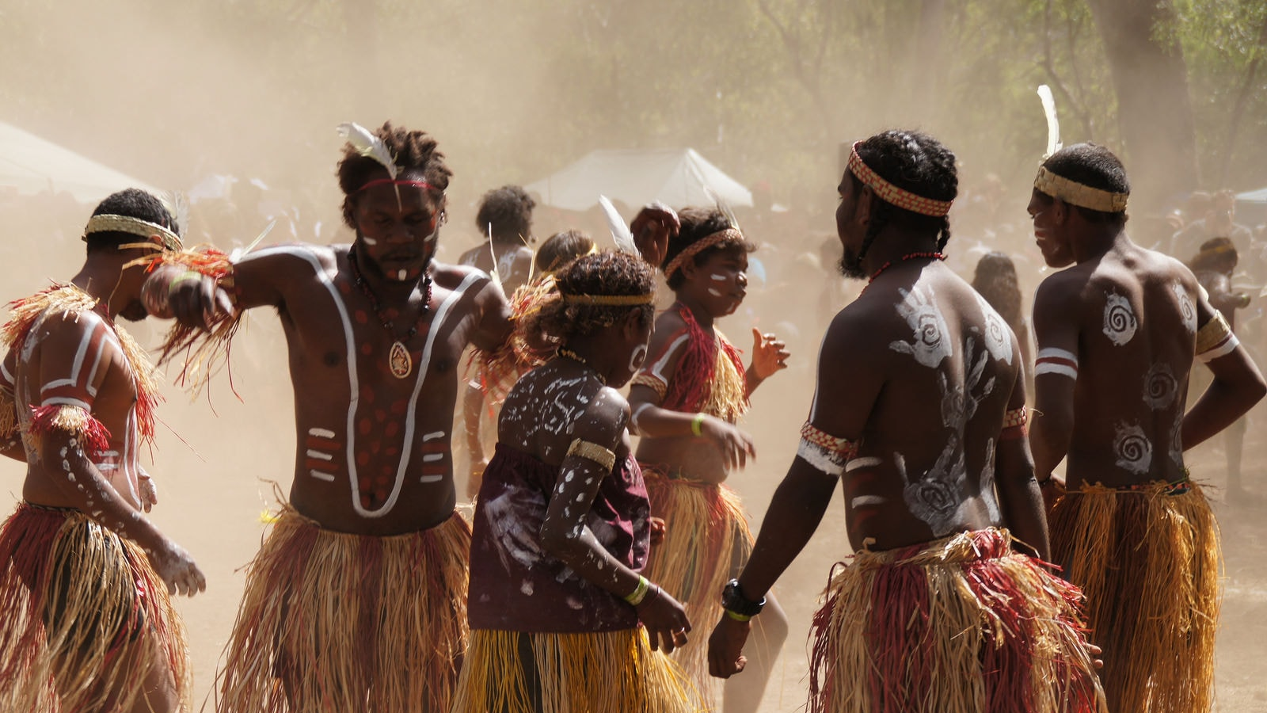
DECOLONIAL STRATEGIES (MOD. B)
MsC “European and Global Studies”
“For education to be meaningfully driven, Indigenous diversity in knowing, learning, and doing must be embraced by educators”. (Flint et al., 2014)
"INDIGENOUS ART AS LANGUAGE IN EDUCATION:
CHALLENGING EUROCENTRIC IDEOLOGIES OF LANGUAGE AND CURRICULUM"
Lucía Félix Prieto

Slide 20
RESOURCES
MAIN ARTICLE: Mills, K.A., & Doyle, K. (2019). Visual arts: a multimodal language for Indigenous education, Language and Education, 336, 521-543, DOI: 10.1080/09500782.2019.1635618
RELATED ARTICLES:
Calma, T. (2008). The Protection of Indigenous knowledge’s. In Kiss, K., et al (Eds.), Native Title Report 2008, pp. 211-228. Australian Human Rights Commission
De Sousa Santos, B. (2014). Epistemologies of the South: Justice against epistemicide. Boulder: Paradigm.
Education Council (2015). National Aboriginal and Torres Strait Islander Education Strategy 2015. Accessed Dec 26, 2021. https://www.aisnt.asn.au/uploads/pdfs/NATSI_EducationStrategy_v3.pdf
Flint, S., et al. (2014). Literacy in Australia: Pedagogies for Engagement. Milton, QLD: Wiley.
Mills, K.A., & Unsworth, L. (2017). Multimodal Literacy. In Oxford Research Encyclopedia of Education. doi: 10.1093/acrefore/9780190264093.013.232
Mills, K.A, et al. (2016). Indigenous ways with literacies: transgenerational, multimodal, placed, and collective, Language and Education, 30:1, 1-21, DOI: 10.1080/09500782.2015.1069836
Queensland Government (2019). Embedding Aboriginal and Torres Strait Islander perspectives in schools: A guide for school learning communities. Accessed Dec 26, 2021. https://earlychildhood.qld.gov.au/fundingAndSupport/Documents/eatsips_2011.pdf
https://www.un.org/development/desa/indigenouspeoples/mandated-areas1/education.html
https://isa.edu.au/about-independent-schools/about-independent-schools/indigenous-students/
https://www.aisnt.asn.au/projects/aboriginal-education
https://www.ais.wa.edu.au/aics

