Slide 1
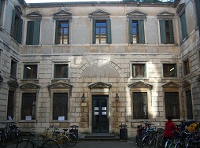
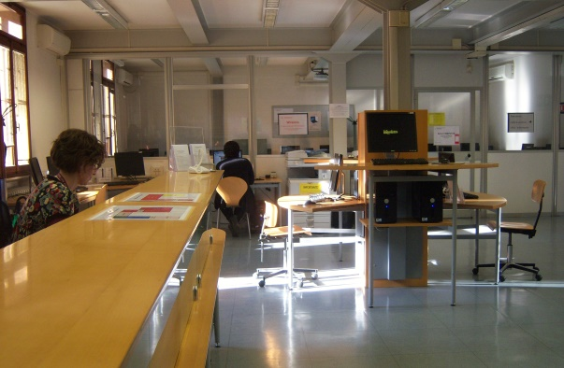
Political Sciences Library
‘Ettore Anchieri’
Bibliographic sources and opportunities
by Maria Cristina Vettore
18/11/2020
Sistema Bibliotecario di Ateneo | Università di Padova

Slide 2
The Academic Library System
Padua University Library system has chosen an organisation by network of libraries. The network of the Social Sciences Libraries is called Polo di Scienze sociali and includes the following libraries:
Political Sciences Library
Ca’ Borin Libraries: Economics, Geography, Social Sciences Newspapers Library
Comparative Law Library
Statistical Library
Sistema Bibliotecario di Ateneo | Università di Padova

Slide 3
Where are we?
Sistema Bibliotecario di Ateneo | Università di Padova

Slide 4
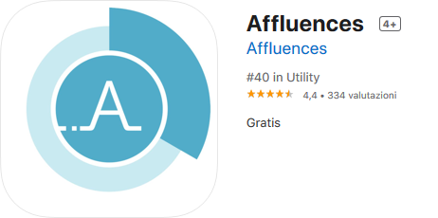
Opening hours:
Monday-Friday 9.00-17.00
Book a sit, a computer or the admission
to the front-office through the app
Fill in the Statement for the entrance in University buildings or show the acepptance Sars-CoV-2 virus control and containment protocol in the app Studenti MyUnipd
Sistema Bibliotecario di Ateneo | Università di Padova

Slide 5
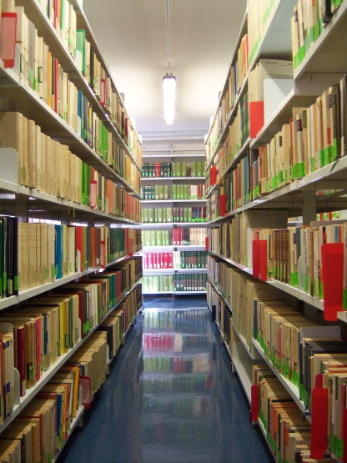
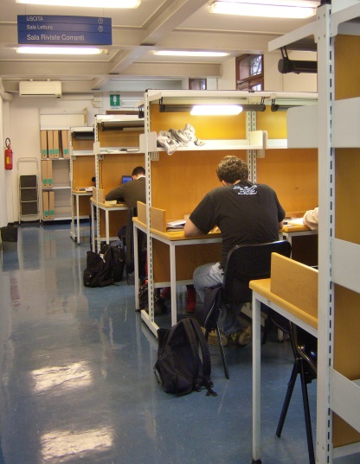
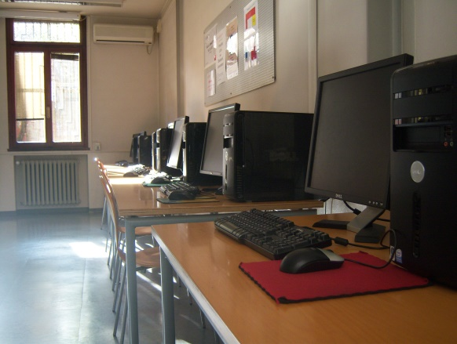
What you can find in our Libraries
Reading rooms
Books and coursebooks
Journals
Copy machines
Computers
Sistema Bibliotecario di Ateneo | Università di Padova

Slide 6
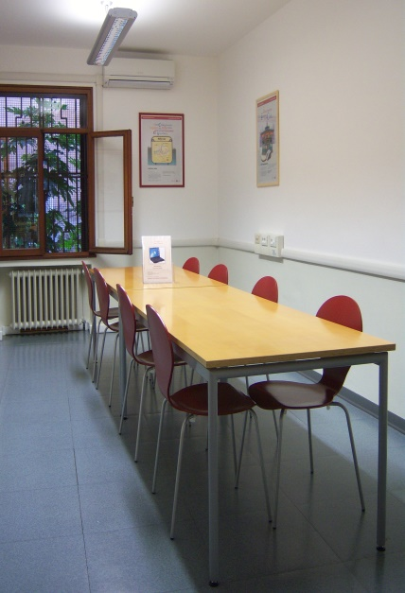
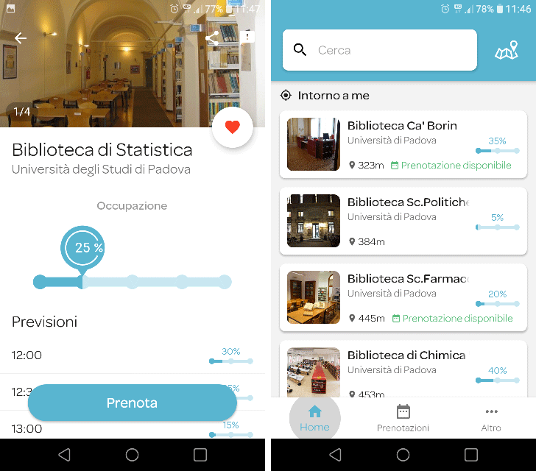
Affluences
Check the Library occupancy in real time on the mobile Affluences application.
The Application shows :
the current occupancy of the Libraries
the forecast for the rest of the day, hour by hour
the opening hours and exceptional closings
practical information, equipments, contacts
the chance to book a seat or the access to the front-office
Download the Affluences application, available for iPhone and Android
Sistema Bibliotecario di Ateneo | Università di Padova

Slide 7
Are you looking for a book, an article or a journal?
Visit the University Catalogue
Sistema Bibliotecario di Ateneo | Università di Padova

Slide 8
It allows an integrated and simultaneous search of the University's document collections starting from a single interface
It is responsive: it can be used in all devices (pc, tablet, smartphone, ...)
It is simple and user-friendly
It is accessible
Sistema Bibliotecario di Ateneo | Università di Padova

Slide 9
Book loan
BORROWING
You must show your student card to borrow a book
You can borrow up to 15 books for a month in a library
RENEWAL AND RESERVATIONS
By the due date you can renew the loan of books that are not reserved up to 6 months. You can also reserve a borrowed book. When the volume will come back, you will be notified by telephone or e-mail.
DOCUMENTS EXCLUDED FROM LOAN
journals (periodicals, magazines, newspapers…)
works printed before 1900, rare books, fine or in poor condition…
consultation documents (encyclopedias, dictionaries, etc..)
Sistema Bibliotecario di Ateneo | Università di Padova

Slide 10
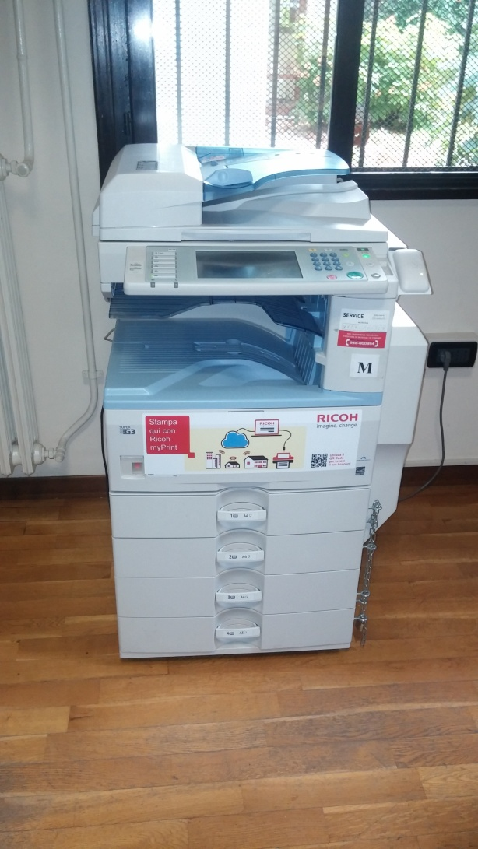
Photocopies
You may photocopy part of books/journals, according to copyright laws, using your student card (register to Myprint service)
http://unipd.albamyprint.it
Sistema Bibliotecario di Ateneo | Università di Padova

Slide 11
Other facilities
WiFi connection is available in many university buildings and city places
or
you can access Eduroam (where available)
Sistema Bibliotecario di Ateneo | Università di Padova

Slide 12
If you don’t find books in Padua
Make an Interlibrary Loan Request (ILL) to
Ufficio Centrale per il Prestito Interbibliotecario
http://bibliotecadigitale.cab.unipd.it/en/interlibrary-loan/interlibrary-loan-service
Sistema Bibliotecario di Ateneo | Università di Padova

Slide 13
If you don’t find a journal article in Padua
Make a Document Delivery Request
through NILDE
It’s for free!
http://bibliotecadigitale.cab.unipd.it/en/document-delivery
Sistema Bibliotecario di Ateneo | Università di Padova

Slide 14
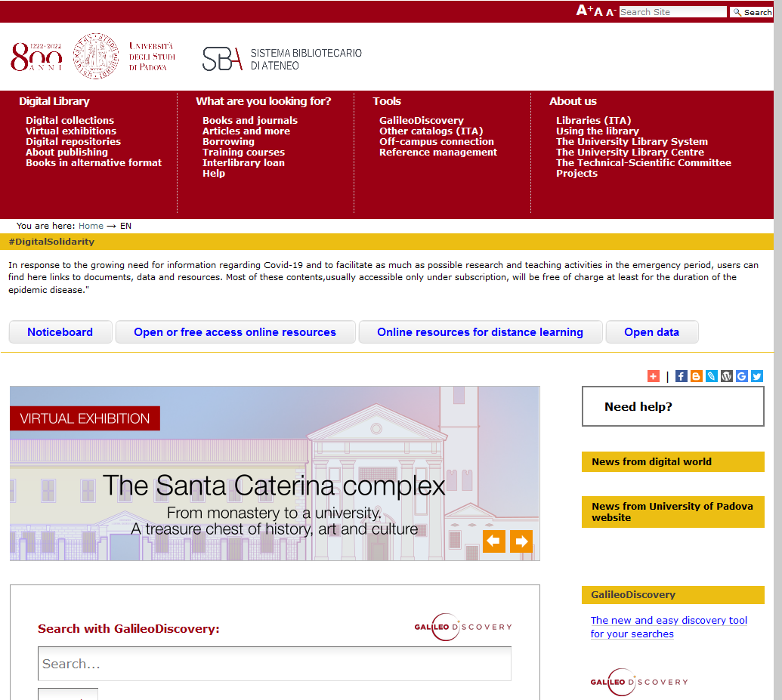
To develop your research
Visit the University Digital Library
http://bibliotecadigitale.cab.unipd.it/en
Sistema Bibliotecario di Ateneo | Università di Padova
Notes:
14

Slide 15
… always with you!
For your connection off-campus use the
Auth–proxy service.
Access the online sources,
Wherever you are.
Remember to respect
copyright rules.
http://bibliotecadigitale.cab.unipd.it/en/auth-proxy
Sistema Bibliotecario di Ateneo | Università di Padova

Slide 16
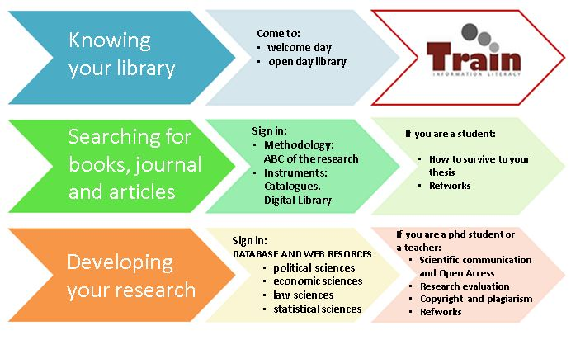
Training courses for you
You may attend our periodical training courses.
http://bibliotecadigitale.cab.unipd.it/chi_siamo/servizi-sba/laboratori-di-formazione
Sistema Bibliotecario di Ateneo | Università di Padova

Slide 17
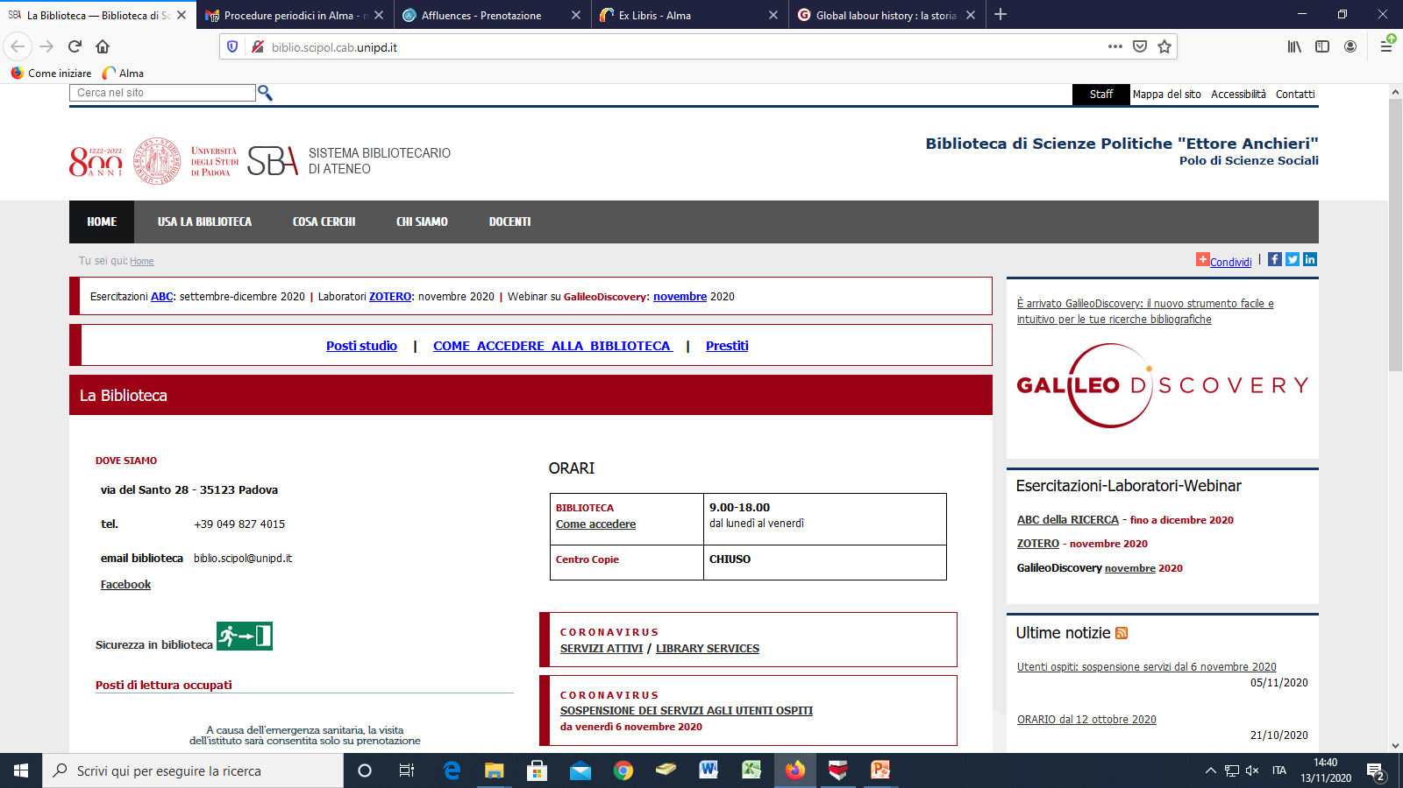
Additional information in our websites
Sistema Bibliotecario di Ateneo | Università di Padova

Slide 18
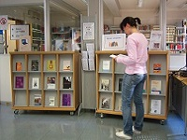
Ask a librarian…
How to....
... search for a book, a journal
... search on databases
... manage bibliographic information
... evaluate and use online bibliographic sources
... and much more!
Sistema Bibliotecario di Ateneo | Università di Padova

Slide 19
To contact us
biblio.scipol@unipd.it
0498274015
Follow us:
Sistema Bibliotecario di Ateneo | Università di Padova

