Slide 1
More in deep:
Complicating categories
From a fordist concept of citizenship linked to employment ( mostly male)
to a new concept of citizenship elaborated by Marshall as a progressive ad linear accumulaton fo righs (but neutral, no struggle)
to a tentative to use the human rights frame to include everybody (neutral)
to the possibility to take into conseideration plurality (which means considering differences as value)---------→ but this is very complicated!!!

Slide 2
Intersectional citizenship of rights
In order to consider differences as values
we need a concept of citizenship of rights able to take into consideration all the links and the margins among all categories
gender + race + class+sexual indentity+religion….
The concept is
INTERNSECTIONALITY!

Slide 3
At the intersection of all categories

Slide 4
evidencing the margins Intersectionality in law
Originally, Cranshaw used ‘intersectionality’ to take a stance against the US courts’ traditional reasoning that,
being based on the logic of sameness/difference and a single category approach, Black women’s rights are systematically left aside, without protection without protection
you have been discriminated on gender basis (because you are a woman), but it makes no difference for the US court if you are a black or a white woman. So the margin between gender and race is without protection.
The new concept/tool of INTERSECTONALITY is intended as to cover this lack

Slide 5
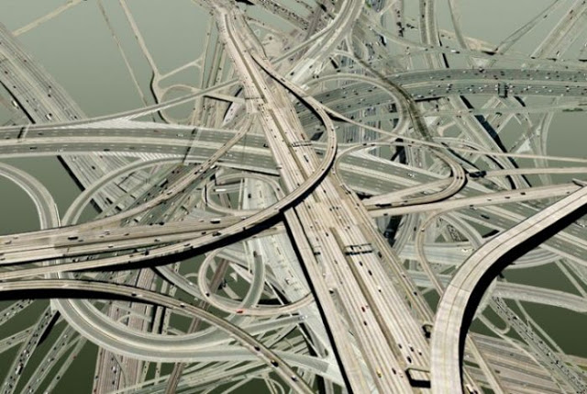
CRANSHOW
“Consider an analogy to traffic in an intersection, coming and going in all four directions.
Discrimination, like traffic through an intersection, may flow in one direction, and it may flow in another.
If an accident happens in an intersection, it can be caused by cars traveling from any number of directions and, sometimes, from all of them.
Similarly, if a Black woman is harmed because she is in the intersection, her injury could result from sex discrimination (she is a woman) or race discrimination (she is a black), but it is very difficult to see her simultaneously from both perspectives (black and woman)

Slide 6
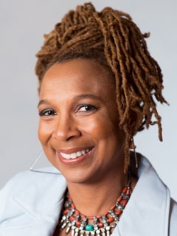
KIMBERLE’ CRANSHOW
https://www.youtube.com/watch?v=ViDtnfQ9FHc
https://www.ted.com/talks/kimberle_crenshaw_the_urgency_of_intersectionality?language=en#t-45672
Kimberlé Crenshaw, (1989) “Demarginalizing the intersection of Race and Sex: a black feminist critique of antidiscrimination doctrine, feminist theory and antiracist politics”.

Slide 7
for Crenshow intersectionality takes on a fundamental character, as it attempts to put together feminist and anti-racist theory.
The aim is to reflect simultaneously on race and gender, as the interconnection of two factors is greater than the simple sum of racism and sexism.
The experiences caused by this double discrimination must not be considered as multiple oppressions, but rather as a single synthesized experience.
GENDER & RACE
BIGGER THAN
GENDER
RACE

Slide 8
Intersection of possibile discriminations
Black
White
…
Muslim
Hebrew
Cahtolic
Indu
…
Migrant
Native
…..
Rich
Poor
woman
man
LgbtqiA+ person

Slide 9
UNDERSTANDING COMPLEXITY: the concept of assemblage or bricolage
Intersectionality is a way of understanding and analyzing the complexity in the world, in people, and in human experiences.
The events and conditions of social and political life and the self can seldom be understood as shaped by one factor. They are generally shaped by many factors in diverse and mutually influencing ways.
Unstable, flexible gatherings of persons and things

Slide 10
From the feminist perspective and practice
In this gatherings of people and things, crossed by many lines of differences (sex, race, class, religion, age…), it is very important to observe what happens at the margins and at the crossroads…
So our initial binary picture of gender as equality between men and women is now a lot more complex and intricated…..

