Slide 1
WOMEN AT WORK!

Slide 2
Historical background 1942: The Beveridge report: A MODEL OF WELFARE
UK: Beveridge report 1942 it is considered the origin of the modern type of welfare.
Based on the consideration that only male are the breadwinners and women are dependent, considered out of the market, attaining equality ONLY with marriage (B level citizens).
Very successfull model of welfare in Europe after the totalitarisms and the IIWW and without counter-models (even Marxism was gender blind).

Slide 4
WANT
IGNORANCE
DISEASE
SQUALOR
IDLENESS

Slide 5
ON THE SHOULDERS OF THE WOMEN
This type of welfare state is totally based on women’s unpaid care work, on their social and biological reproductive work at home.
The State is present but the centre of the welfare system is the family (and the role of women in it)
In Beveridge’s opinion if a woman is married and wants to have a job outside the family, she must pay a sort of «fee» for this, consisting in receiving lower benefits, less services and lower contribution for pension!
Being married was a privilege, an insurance in itself, according to Beveridge.

Slide 6
UK – USA: women at risk of poverty
The Beveridge System, very similar to the views of J. C. Hoover in USA after the crisis of the 1929 based on a huge proliferation of the working class through a massive State politics addressing the lower middle class, living in white and green peripheires, voting for republicans, devoted to a certain type of family in which women are secluded inside the house with children and men are the onlyy ones to take the car to go to work every day carring all the responsabilities (Remember Betty Friedan the mistique of the femininity, 1963…..)
The system on both sides of the Ocean, increased the consistence of the working class giving them the illusion of the protection of the State
through a false idea of «equality»,
but with the side effect of putting women at the very risk of poverty!
When Margaret Thatcher was elected in England (mid Seventies) 61% of the poor in England in 1980 were women! From all social classes. She opted for fostering this type of welfare!!!!!! And the same did Ronald Reagan in USA.

Slide 7
Why the model was so successful
Beveridge used dependent housewives as an effective incentive for husbands to remain economically active in the labour market.
Sanctions were also inflicted on those males who neglected to provide for their families
Low benefits to people in general, in order to encourage the assumption of personal responsabilities
For women there were almost no alternatives
The idea of the “value of the family” make them blind (even black women – for them the house and the marriage were at that time symbols of freedom from slavery)
The issue of «salary for domestic work» was a big political point (the salary consisting in not paying for this and that, according to Beveridge!!!)

Slide 8
The reaction of women in UK and USA
How and when women reacted to this state of things?
They did’t react until the mid seventies. they didn’t have a collective voice, divided in class, in single houses in the suburbs, alone, disconnected from a non existing neighborhood, not educated, dependent.
They didn’t understand immediately the disadvantage of being a houswife… neither men didn’t understand the problem for them (the heavy burden of responsabilities of being the breadwinner….)
The Beveridge (and Hoover) method was never really rejected (Thather and Regan adopted part of it)
There were women in the Beveridge committee!!!!
Moreover: maternity is a value for most of women in UK (even for part of the feminist movement in USA)

Slide 9
Popularity of the Beveridge «method»
A good mix od socialism and liberism, the Beveridge method became very popular all over Europe, and the Italian system of “stato sociale” with pension calculated with the “contributive” system was a lot influenced by the UK system
Beveridge’s views were largely in accordace with those of the majority of the organized women’s movement in Britain in the 1930s and 1940s (giving value to maternity, even in the seventies….)

Slide 10
Effectiveness of the method
The system gave precedence to tangible material benefits such as family allowances, instead of stressing on the more abstract concept “equal rights”.
As a result, those who criticized Beveridge, and who desired equal pay, equal employment access, and an end to the marriage bar were effectively marginalized.

Slide 11
The «method» as a moral system
The Beveridge’s method punished with less contribution for the pension also men drinking alchool and smoking
this was considered a sort of equality for many women – «we are penalized if we fine a job outside family, they are penalized for their vices»

Slide 12
Illusion of equality, illusion of a bottom up «system»
The welfare state was not seen as the creature of any one particular group in British society, but something in which many diverse groups and ideological traditions had shaping hands; groups which included from one side for example businessmen, accountants and enthusiasts for Prussian-style state corporatism, as well as people who believed in brotherly love, community progression and democratic socialism.
«With a COMPULSORY CONTRIBUTION citizen are building their own State», yes, but they were all poor! (and women dependent)

Slide 13
Considerations…..
it is interesting to interlace the chronology of the «cultural revolution» of the mid-sixties and of the Seventies (with the struggle of the feminist moviment)
With the persistence of these type of welfare state neglecting women equality
In Uk they had the right to vot very early, the abortion law was one of the first implmented and one of the more «open» to women’s choice… but the economic and social system considered them second level citizens

Slide 14
what about today, after the cultural revolution… EU and the international institutions are always fixing new goals and targets
The last EU committment
75% of the population aged 20-64 should be employed by 2025

Slide 15
EU Strategic engagement for gender equality 2030
Some progresses have been achieved in recent years, for example, by the highest employment rate ever recorded for women (64 % in 2014) and their increasing participation in economic decision-making.
However, this upward trend is offset by persistent inequality in other areas, e.g. in terms of pay and earnings meaning that the key areas identified in all the previous documents of the EU are still valid today.
In its work programme, the Commission has reaffirmed its commitment to continue its work to promote equality between men and women. This means maintaining the focus of gender-equality policy on the five existing thematic priority areas:
increasing female labour-market participation and the equal economic independence of women and men;
reducing the gender pay, earnings and pension gaps and thus fighting poverty among women;
promoting equality between women and men in decision-making;
combating gender-based violence and protecting and supporting victims;
promoting gender equality and women’s rights across the world.

Slide 16
The reality

Slide 17
EIGE DATA
http://eige.europa.eu/sites/default/files/documents/mh0415169enn.pdf

Slide 19
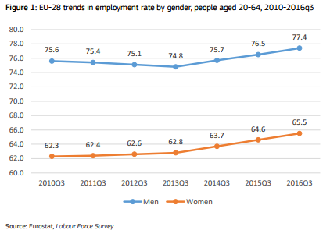
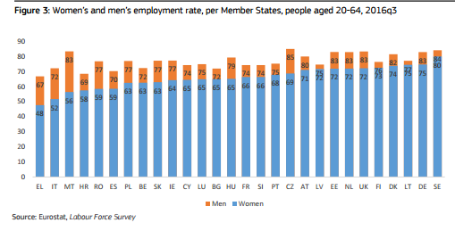
According to the 2017 Report on equality between women and men in the EU, men and women’s employment rates have improved, but the gender gap is still a lot evident.
In the third quarter of 2016, the employment rate for men stood at 77.4 %, while the employment rate for women reached an all-time high level of 65.5 %.

Slide 20
Employment’s rates
In all Member States
female employment rates are lower than
those for males with strong variations across the EU.

Slide 21
Reasons for gender gap in labour market
Parenthood is one of the main factors underlying the gender employment gaps.
The employment rate for women who have children is much lower than for women without children in most Member States (with the exception of Slovenia and Portugal)
while it is the opposite for men.
The employment impact of parenthood varies considerably across the Member States and is extremely high in some cases.

Slide 22
Women have care duties
Parenthood affects symmetrically men and women's employment,
but women are more often involved in childcare duties when care services are lacking or not meeting the needs of - full-time - working parents as it is the case in many Member States.
It depends on the system of Welfare, of course, and of its efficency!!!!

Slide 23
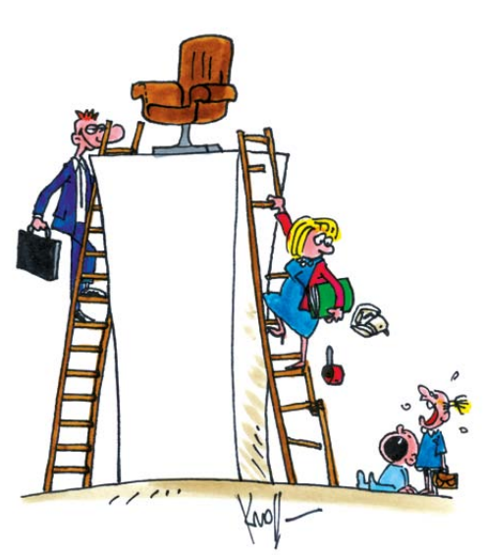
The reality

Slide 24
Gender gap widening through the life time
Furthermore, the longer women are out of the labour market or unemployed notably due to care duties, the more difficult it will be for them to find a job in the long term.
The gender employment gap is widening through the life cycle and reaches a peak for the older cohort (55-64).

Slide 25
The reality

Slide 26
The gap
The gap between men and women in employment rate is
8.3 %for the young cohort (20-29 years old)
12.4 %for the middle age cohort (30-54 years old)
14.5 % points for the older cohort (55-64 years old).
The employment rate for the older cohort is strikingly low in some cases.

Slide 27
gender gap means:
Lower labour market participation of females
differences in type of their labour market participation (their over-representation in part-time jobs associated with lower hourly earnings and lower career prospects),
shorter and more discontinuous working lives – stemming from parenthood, care roles and the traditional division of unpaid work –
smaller human capital investments combined with segregation and other forms of discrimination

Slide 28
Lack of care facilities - fewer career options
breaks in working life
resulting in fewer career options
later combined with lack of care facilities
can push senior females out from the labour market to provide care for grandchildren or elderly individuals

Slide 29
Gender gap in labour -> gender gap in pensions
The prevailing gender gaps in the working age population result in wide pension gaps between women and men.
GENDER GAP IN PENSIONS –> POVERTY!!!!!

Slide 31
RANKING OF… POVERTY!
The highest gap between male and female employment rates is to be found in Malta (around 32 percentage points).
Italy, Greece, the Czech Republic, Luxembourg, Slovakia, Poland, Romania and Cyprus, also face higher differences between female and male employment rates than EU average
• a female employment rate under 60% in Malta, Greece, Italy, Hungary, Spain, Romania, Poland, Slovakia and Ireland, is particularly challenging for these Member States since most of these member States also face severe demographic ageing and the main potential for labour supply lies with women;
LESS WOMEN IN LABOUR MARKET -> a problem of social justice but also
A lOSS OF WORKFORCE!!!

Slide 32
PART TIME and shared WORK: A SOLUTION OR NOT? IT REINFORCES THE STEREOTYPE OF WOMEN DEVOTED TO CARE
the share of part-time employment among women is very high in some Member States, some of which have high female employment rates but these rates are diminished when measured in full-time equivalents (see figures 2 and 10).
The situation is very typical in the Netherlands, where almost 80 % of employed women worked parttime in 2012, but it is also high in Germany, Austria, Sweden, United Kingdom, Denmark Belgium and Luxembourg (BECAUSE IT IS WELL PAYED IN THESE COUNTRIES!)
On average across the EU, men work 7 hours more than women in a week. While several cases part-time reflects preferences, the high share of part-time employment may also stem from constraints such as lack of care services or low financial incentives to take up full-time work.

Slide 33
WOMEN AS INACTIVE WORKFORCE:
More than 10% of the potential workforce is inactive or work part-time because of personal and family responsibilities in the Netherlands, the United Kingdom, Austria, Germany, Italy and Czech Republic…

Slide 34
CHILEDCARE COSTS AS DISINCENTIVE TO FIND A JOB
Childcare costs can be a further disincentive to start or return to work for a second earner.
The situation is even worse for low-income families.

Slide 36
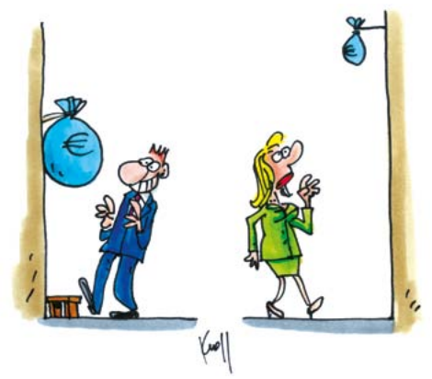
Reducing gender pay, earnings and pension gaps and thus fighting poverty among women
The gender pay gap is the difference in average gross hourly wage between men and women across the economy. The average gender pay gap in the EU is 16.3%
The gender overall earnings gap is the difference between the average annual earnings between women and men. It takes into account three types of disadvantages women face:
lower hourly earnings;
working fewer hours in paid jobs;
lower employment rates (for example when interrupting a career to take care of children or relatives).
Some of the factors that contribute to the gender pay gap are:
Management and supervisory positions;
Women take charge of important unpaid task;
Women tend to spend periods off the labour market more often than men;
Segregation in education and in the labour market;
Pay discrimination

Slide 37
GENDER PAY GAP
The gender pay gap remains high in Europe (16.2% in 2011) and is particularly high In Estonia, Austria, the Czech Republic and Germany
The at-risk of poverty or social exclusion for those over 55 is higher for women in all Member States.
Though it also can reflect the specificities of the pension systems and also the fact that women live longer than men, important causes lie in the employment related challenges facing women.
The at-risk of poverty or social exclusion rate is particularly high in BG (over 60%), but also quite hight in CY, LV and RO (above 40%).

Slide 38
A puzzling scenario….
A bright scenario in which women are about to surpassing men in one of the most important field: EDUCATION
In which women are about to earn more than men in some sectors
(good sets of skills, like flexibility, attitude to adaptability, to listen to people, to interact…. Skills that -the market the society- believe women have «naturally»)----- these are the skills they learned at home, in care duties for centuries!!!!!
Nothing is NATURAL in this!!!
(remember the lessons on stereotypes and on masculinity….)
https://www.ted.com/talks/hanna_rosin_new_data_on_the_rise_of_women

Slide 39
What if we consider other perspectives…
Are these the main issues of inequality all over the world?
Do all women and discriminated people in the world looking for the same solutions in order to overcome inequalities?
Western institutions say: these are your problems – gender pay gap, career, violence, objectification and these are the solutions- laws, normatives, practices.
These are the goals you have to reach, these are the standards and so on… but…

Slide 40
Alternative: claiming an ecological transformation
Facing mass unemployment, precarization, evictions and cuts in social services, more and more people around the world are reconquering public spaces in order to create new forms of production and reproduction:
The Commons
It is not just about urban gardening, re-appropriation of public spaces in the cities, water, or land ,
it is about practices of collective use of spaces and sharing of duties, reconstructing the social fabric, the relationships in the community (“bonds of solidarity”)
These "communities of resistance" could become - when they join into networks - a vital force of social and ecological transformation.

Slide 41
Overcoming disegualities
SILVIA FEDERICI ON FEMINISM AND REPRODUCTION
https://www.youtube.com/watch?v=CDf0NDNfWEQ&ab_channel=ThePeople%27sForumNYC
SILVIA FEDERICI ON «THE COMMONS»
https://www.youtube.com/watch?v=oJwFT3a3J_4&ab_channel=KontextTV
https://systemicalternatives.org/2017/03/27/ecofeminism-2/
http://www.hotpotatoes.it/2020/10/01/il-femminismo-marxista-della-rottura-anna-curcio/
https://www.youtube.com/watch?v=d7v8vorm3sg&ab_channel=SBSUMass

