Slide 1
Freedom of expression
A civil right in danger

Slide 2
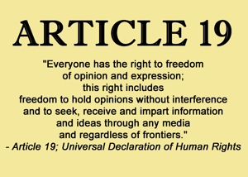

Slide 6
The case of the Belarus Students
https://www.youtube.com/channel/UC0en3EJu_YD7ufAK0t6StNg?app=desktop&fbclid=IwAR1cLUPiwzADbA3xvIZGWE4QRf4JH8SBMN93965onsBWLJqW2cl9VJpA5_s

Slide 7
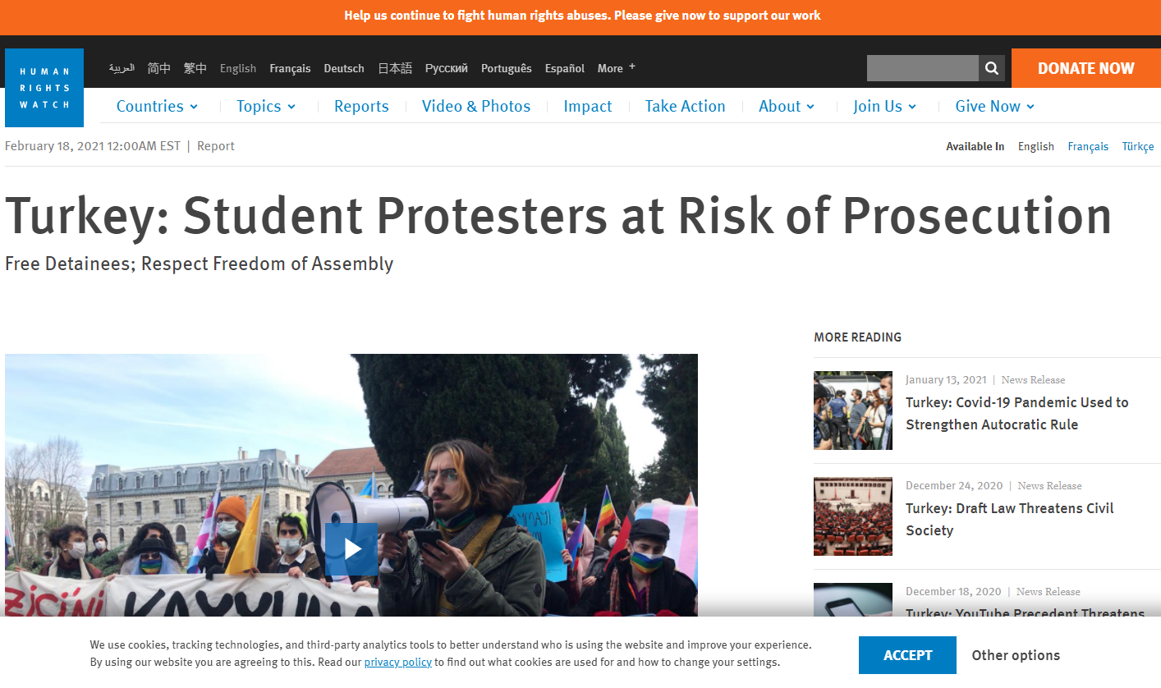

Slide 8
A right that is neglected not only under dictatorships, not only due to repressive laws even in democracy and under the best laws and intention of the governements we are not free to express ourselves due to:

Slide 11
Who make the news? Who produce the data? Who is writing the history?
what we know is often just one part of the story…

