Slide 1
Gender Eu politics
and Globalisation

Slide 2
Professor Lorenza Perini
Degree Master degree in European Global Studies
Language all lectures are held in English.
Teaching period 2nd year – 1st semester
Credits 6 ECTS – 45 hours
Zoom link: https://unipd.zoom.us/j/3976717319

Slide 3
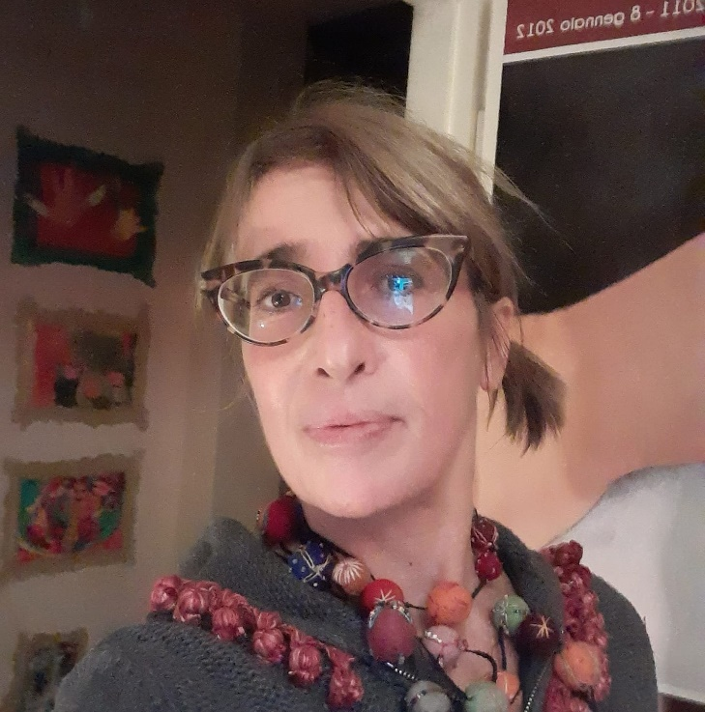
Hi, I’m Lorenza Perini
Researcher at the Political Science Dept. of the University of Padua.
I currently teach “gender policies”, both at the basic level degrees and at master level degrees.
I am a member of the Equal Opportunities Commission (CUG), of the Regional Studies Research Centre (CISR) and of the Gender research Center (CEC) at UNIPD.
I have a PhD in Contemporary History and another in Urban Planning
My research field is placed in a context of investigation at the intersection of
1. The citizenship of rights (different path for women and lgbtqia+)
2. the FEMINIST perspective in the policy making process: are policies built with a perspective of inclusiveness, non discrimination and with a perspective of freedom for all from the beginning or not?
3. The right to the city and the impact of urban planning and policies on people

Slide 4
Interaction debate attendance strongly recommended!!!

Slide 5
timetable
Days: MONDAY and TUESDAY
When: 28th Feb to May 24th 2022
Where: Monday: Aula Comune; Tuesday: Aula N
Time: 2.45 pm to 4.15 pm
(in case of persisting overlapping with other lessons, you can rely on the recordings uploaded in the moodle page)

Slide 6
EXAMINATION
At the end of the class, all students are asked to:
Choose a topic of interest and start collecting sources on it
Presenting the research design&framework to the rest of the students in a PPt presentation
Produce a paper (5000 words more or less) on the chosen topic
(instead of a scientific paper it is possible to produce a video essey, a slideshow with comments, a video, or … you can use the mean you like best!!!!)
There are no «non attending students», since all lessons will be recorded and posted in the moodle page

Slide 7
All students
are supposed to check
the moodle page
of the course frequently
(no password)

Slide 8
ricevimento
I’m available at the end of each lesson, and I receive students also in zoom on FRIDAY at 6.30 pm
https://unipd.zoom.us/j/3976717319
Check frequently the «pagina docente» at this link for any variation:
https://www.didattica.unipd.it/off/docente/5ADED323F22242984E22A07E268DAEA4
Please limit the use of the emails.
I have a lot of students and it is very likely for me to miss your message!
Anyway, my email is: lorenza.perini@unipd.it

Slide 9
Teaching in a gender perspective
Aim of the course: make you see things more in deep and in details than you usually do!
The GENDER PERSPECTIVE is a way to wide your usual categories of analysis.
Nothing is NEUTRAL, everything can be seen through the spectrum of GENDER, which is not linked to biology but is a social construction, is the way in which the society we live in, expects that women and men act. A perspective that depends on us and it can be changed, it may vary (hopefully)

Slide 10
Gender is not a subject to teach…
So Gender is not a real subject to teach
there’s no manual for this topic
GENDER IS NOT A TOPIC
but
it is rather
a perspective, a point of view, a cross-cutting category
(Joan Scott, Gender, 1986 see moodle page)
In taking “gender” into account as a category of analysis, students are asked to re-think at what they already “know”, at their daily experience and at their research interests using a new and wider perspective, not neutral but multiple or – better- intersectional.
The aim is to make them aware of the fact that in looking at the reality as a “neutral” issue you can miss a lot of details, while, with a gender perspective, it is possible to see many more things, details hidden before. And sometimes these details are the ones responsible of discriminations and inequalities in society.

Slide 11
keywords (explaining the title of the course)
Gender (and feminist perspective)
Politics&policies
Globalization
+ INTERSECTIONALALITY

Slide 12
What GENDER is not
Gender is not sex!!!
Gender is not women !!!

Slide 13
What gender is (for me)
Gender is a cultural construction
It is not biology,
it is not about biological sex.
it indicates both the perception that each person has of him/herself as male or female (i.e., gender identity),
but also a culturally constructed system of roles&rules we are expected to play in order to be recognized ad “men” or as “women” by the society we live in (femininity/masculinity).
In one word, it’ a cage!

Slide 14
Breaking (or better Enlarging) the cage
Gender is not women
Gender indicates relationships among sexes according to social expectations
But it is not enough to describe ourselves, the multitude of identities and differences that we are
Outside, around women&men relationships there is a lot more that exceed these fixed and stereotyped roles

Slide 15
We need more words
So gender is not enough,
we need more categories of analisys
LGBTQIA+
INTERSECTIONAL DISCRIMINATIONS
RACE
CLASS
PATRIARCHY
…..

Slide 16
Sex, race and class: differences ascribed to biology and “nature” are used to justify gender discrimination
Biological differences among human beings, such as SEX and RACE, have traditionally been used as grounds for social and political inequality, discrimination, subjugation, and oppression
From the social perspective CLASS: The division of social roles between men and women in the family is historically the earliest form of division of labour and the earliest class division.
PATRIARCHY (literally, “the rule of the father”, now understood as the dominant role of men in society) is the oldest form of social inequality
Perception of patriarchy as a “NATURAL order”.

Slide 17
other keywords in the title
Politics (translated here as power relationships producing rules, codes, international and national legislations, treaties, charters, recommendations, directives. Do they affect men, women LGBTQIA+ people in the same way?
Policies are the translation of politics into everyday practices. They are “Politics for real”. What does “gender policies” means? Is it possible to have “non gender”/”gender neutral” policies?

Slide 18
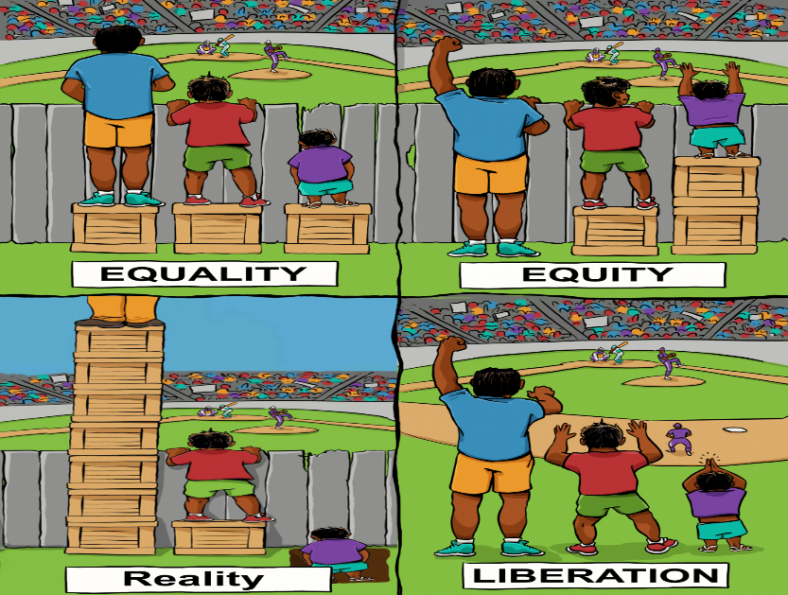
We can fight for equality or for equity, but the real goal is freedom!

Slide 19
describes the way countries and people of the world interact. Many things have become globalized as people come into contact. (more related to economy and trades, less to right and issues like people and equality….) INTERACTION IS NOT A FARE mechanism….
GLOBALIZATION
https://www.un.org/sustainabledevelopment/sustainable-development-goals/

Slide 20
interpreting the SDGoals
How can you achieve sustainability, or peace or how can you beat poverty or famine
equality of rights in society?
(intended as FREEDOM OF CHOICE, EQUAL TRATMENT AND
ACCESS TO RIGHTS FOR ALL)

Slide 21
Then, the most important keyword (for me)
Feminism(s)
what does feminism means?
We will discuss the role of the feminist movements to define, establish, and achieve equal political, economic, cultural, personal, and social rights for all, not just for women!!!!!
In my opinion Feminism is freedom for all
is changing the paradigma of patriarchy and capitalism, not just adapt to them, find a place to stay into them!
FEMINISM is a transformative force, more than GENDER EQUALITY
(which is important, but represents the effort to be equal to someone else within the system)

Slide 22
If this is GENDER EQUALITY AND EQUAL OPPORTUNITY (your equality depends on policies, on epscific measure)
This is FEMINISM:
a transformation in the sense of
RIGHTS and JUSTICE FOR ALL (your equality depends on the condition of freedom of all the people)

Slide 23
So be critic and put everything into question!

