Slide 1
IMPOSITION
AND
DISPOSSESSION
Martina Garbato, Lucrezia Manassero, Annalisa Giasi

Slide 2
The western epistemological imposition in the modern and fordist era

Slide 3
Taylorism, fordism and post-fordism
An American mechanical engineer. He was widely known for his methods to improve industrial efficiency.
In 1911 he published “The Principles of Scientific Management,” in which he summed up his efficiency techniques.

Slide 4
Rationalization as the key word : speeding up the production process, which eventually becomes broken down, fragmented and reassembled.
There were three steps:
Analyzing the characteristics of the job to be performed,
Creating the worker prototype suitable for that type of job,
Training the worker to make him look like the prototype
He proceeded by gathering all the traditional knowledge to schematize them and transform them into mathematical laws, where possible.
An undesirable consequence of Taylorism was alienation, of which philosophers such as Feuerbach, Hegel and Marx have spoken

Slide 5
TAYLORISM
One best way: sequence of movements implemented by the workers to reach the maximum efficiency with the minimum effort
Scientific selection of the workforce: searching for the right worker in the right place to obtain maximum performance
Breakdown of production cycles
Working times: with the stopwatch the working times were measured with the aim of eliminating wasted time
The coach: workers had to follow the example of the fastest worker
Advance job planning: the workers' knowledge was transformed into written orders and workers lost the freedom to choose how to act

Slide 6
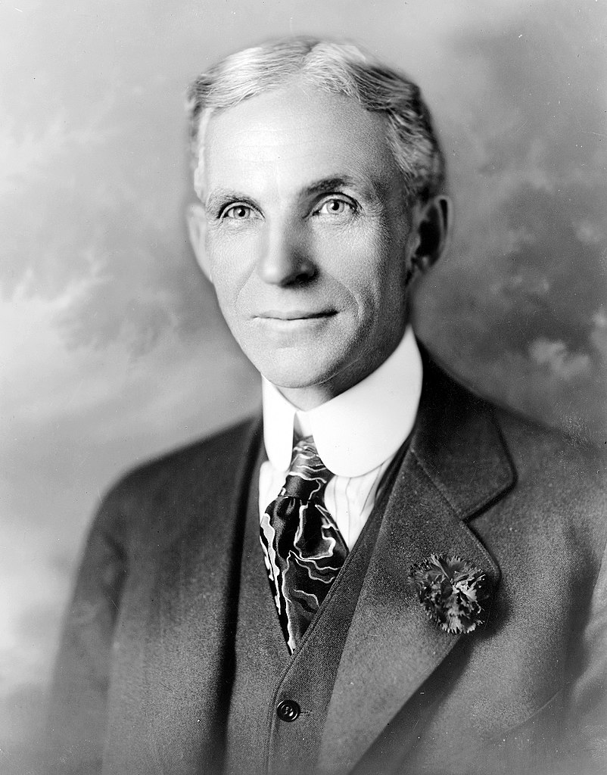
FORDISM
In the 1910s, Henry Ford in his car company in Highland Park (Chicago) perfected Taylor’s system and introduced the assembly line.
The term Fordism refers to an industrial production system designed for mass production. the production process was based on interchangeable elements, a clear division of labor and product standardization. Antonio Gramsci and Henri de Man were the first that used the word, with a negative connotation.
The generous wage was a form of reparation for the alienating regime in which the Ford worker lived. Unlike in Taylorism, it was recognized that productivity could also grow through these types of material incentives.

Slide 7
Post-fordism
Fordism went into crisis between the 1950s and 1960s due to rampant unemployment and slowed economic growth.
They moved from a manufacturing and industrial orientation to an economy of knowledge.
Meanwhile, the industry started relocating and moving to where production is cheaper.
Nation states were gradually withdrawning from the economic sphere.

Slide 8
Instead of investing enormous sums in the mass production of a single commodity, firms attempted to build intelligent systems of using labor and machines that could satisfy the whims of the market.
Production costs rose during the energy crisis of the 1970s and consumers were no longer satisfied with a narrow range of models. Improvements in electronics and information technology made it possible to reorganize the production and distribution of products. Fordism turned out not to be flexible at all.
Just-in-time production, tested by Toyota, made it possible to reduce warehouse costs and expand the range of models. now it is the consumer who dictates the production process and his demand determines production.

Slide 9
Workers now have the right to think and solve problems, so it is necessary to collaborate with managers.
The factory is no longer the only place where to produce, but the company subcontracts some of its previous activities to other companies (outsourcing).
By offshoring, companies transfer some activities from the territory of the State where the company is based to a foreign country, to reduce costs.

Slide 10
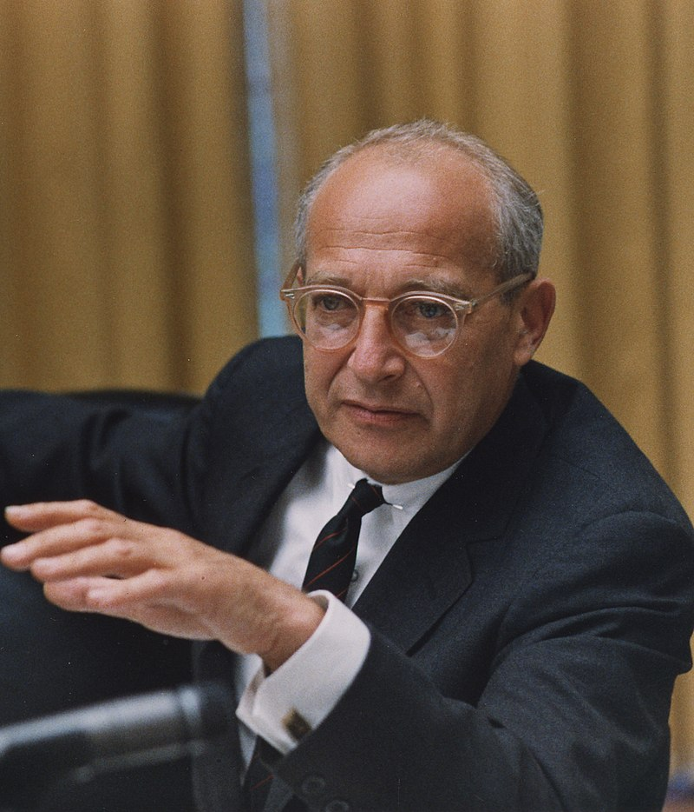
The Stages of Economic Growth- A non-communist manifesto
He was an American economist, professor and political theorist who served as National Security Advisor to President of the United States Lyndon B. Johnson from 1966 to 1969.
He thought that “underdeveloped” countries were based on agricultural types of economy and that, with the emergence of “development”, their economical structure had to change in order to give room to manufacturing activities and services.
According to him, investing in these activities was a stimulus for economic growth.

Slide 11
Rostow’s stages of growth

Slide 12
Criticism to Rostow’s model
It assumes that each country starts the development process
from the same starting point but does not take into account cultural, social and economic differences.
It is based on a very narrow understanding of development based on a linear economic growth pattern.
Not all countries develop so smoothly, some skip steps (leapfrog) or take different paths. It imposes the Western experience as a model of development
The West believes that his own system of knowledge is the only valid one, that it is the episteme to be opposed to the various doxai

Slide 13
The model does not take into account the fact that receiving economic aid from another country could stimulate economic growth in the short term but also lead to high levels of debt that compromise long-term growth.
The model is strongly Eurocentric in the way it imagines that development leads to a modernized and technologically advanced “Western” society
The theory assumes that what worked in the past for the West must necessarily work for non-Western countries today as well

Slide 14
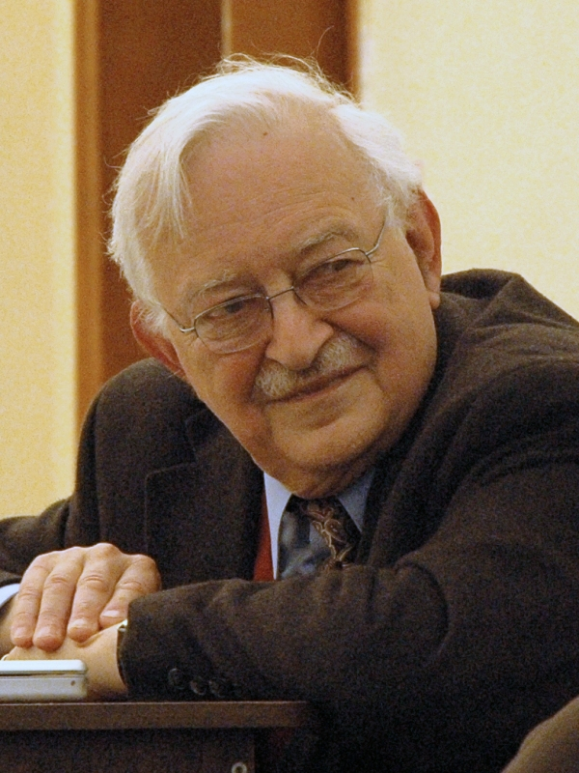
The modern world-system (1974)
An American sociologist and economic historian.
He thought that capitalism was responsible for underdevelopment and dependency. In his view there were no First nor Third world, but a world-system made of
Core
Semi-periphery
Periphery
In which strong countries (the «core»), which are militarily and economically sound and stable, subdued peripheral countries and often colonised them.
Those weak countries have not a diversified economy and must rely on the core in order to survive.

Slide 15
SAPs
In neoliberalism, structural adjustment programs (SAPs) have taken hold.
Structural adjustment programs (SAPs) consist of loans (structural adjustment loans; SALs) provided by the International Monetary Fund (IMF) and the World Bank (WB) to countries that experience economic crises. Their purpose is to adjust the country's economic structure, improve international competitiveness, and restore its balance of payments.
In order to receive these funds, the countries in question must implement market reforms such as devaluing the currency and reducing inflation, but also reducing the role of the state in the economy, reducing state spending on public services and encouraging foreign investment.

Slide 16
SAPs require the reduction of state spending on public services, so it happens state hospitals which obtain way less money have to charge people for some services and reduce their staff. With less money in agriculture, groceries cost more and more.
By devaluing the currency, all imported goods go up in price.
Against neoliberism’s point of view (and its concrete realisation, the SAPs, there is a new critic) theory nowadays known as «The gap-widening theory»: according to its supporters, globalization and SAPs act against the achievement of equality.

Slide 17
DISPOSSESSION AND INDIGENOUS STRUCTURAL CRITIQUE
Through the analysis of Robert Nichols in his book «Theft is property! Dispossession and critical theory» (2020)

Slide 18
DISPOSSESSION
In large sections of the globe, Indigenous peoples have not only been subjugated and oppressed by imperial elites; they have also been divested of their lands, that is, the territorial foundations of their societies, which have in turn become the territorial foundations for the creation of new, European-style, settler colonial societies

Slide 19
19th century: Anglo settler societies acquired 9,89 million square miles of land: more or less 6% of total land on the surface of Earth
Conquest of Indigenous’ lands by annexation, purchase, temporary lease or rent, military occupation, squatting and settlement through violence, coercion, fraud but also other more peaceful and transparent methods

Slide 20
DISPOSSESSION: A PROCESS WHICH TRANSFORMS NON-PROPRIETARY RELATIONS INTO PROPRIETARY ONES
Indigenous people argue that earth belongs to no one, and they simultaneously claim that land was stolen from them
Nichols claims that possession does not precede dispossession, as we might think, but it is its effect: this process transforms nonproprietary relations into proprietary ones
It is not about the transfer of property but the transformation into property
Dispossession creates an object in the very act of appropriating it

Slide 21
ALIENATION AND DIREMPTION
Dispossession as an historical process of diremption within systemic alienation:
Standard form of property right = tripartite conjunction composed of:
rights to acquisition
rights to use and enjoyment
alienation
“Indigenous property”: truncated form of property that could only be fully expressed in the third moment, alienation. It is fully realized only in its negation.
Vine Deloria Jr.: “Custer Died for Your Sins” (1969)- The right only to sell
Diremption: internal division of society as a function of the domination of some by others: colonizers and colonized

Slide 22
DISPOSSESSION: A RECURSIVE PHENOMENON
Each iteration is not simply a repetition of the last, but builds upon or augments its original postulate
Dispossession was augmented and amplified elsewhere

Slide 23
INDIGENOUS RESISTANCE TO DISPOSSESSION: STRUCTURAL CRITIQUE
Not concerned with one particular event or action in isolation, but with the overall effect of a macrohistorical process
Importance of the temporal window of examination: in the context of expropriation of Indigenous’ lands, unforced agreement of today may look differently if we consider the preceding events
Nichols evaluates this process from within a large temporal window: the entirety of 19th century
Similar system of dispossession in the lands of Canada, Australia, New Zeland and USA

Slide 24
INDIGENEITY
late 18th century and early 19th century: new form of pan-Indigenous political mobilization > new traditionalism > great tradition of critique to dispossession practice
“accomodationists”: Indigenous who adopted European lifestyles > tensions and contradictions
indigeneity is a politics: a contested terrain of discursive and material struggle that simultaneously unites and divides people as individuals and collectivities
Indigeneity was partially formed not only in the shared experience of being targeted by dispossession, but also in common resistance to it

Slide 25
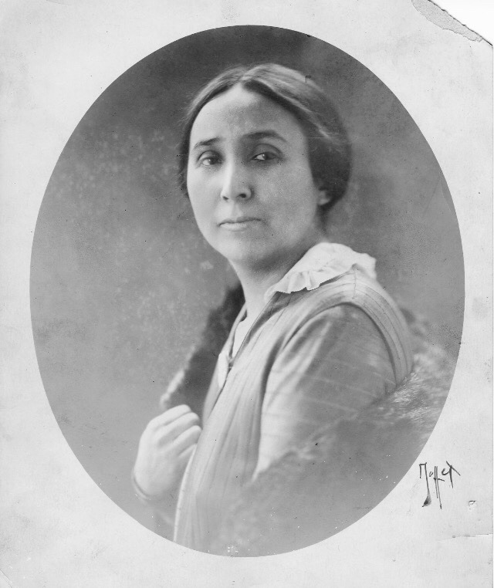
Example of structural critique: Laura Cornelius Kellogg (1880-1947)
Oneida leader, author and political activist
“Our Democracy and the American Indian” (1920): defence of Haudenosaunee sovereignty and self-government: critique to Anglo-Americans’ inconsistent and selective defence of private property
“the Indian himself does not know what theory to advance to save himself and his possessions, but he realizes that the concrete thing he wants is to save them”
Founding member of the Society of American Indians (1911-23)
Need to forge pan-indigeneity by giving it an institutional structure supported by a new political economy: “Indian communism”
Reconstructive dimension of Indigenous political critique

Slide 26
BELATEDNESS OF STRUCTURAL CRITIQUE
“Belatedness”: term from Freudiand theory and Freudo-Marxist works of early Frankfurt school thinkers
Borrowing this feature from the dimension of traumas: not identifying it with dispossession
Indigenous appear the owners of their lands only retrospectively: belated and not contradictory critique (belated theft)
My analysis: critique is not contradictory also because dispossession goes beyond its material dimension: it is occurring nowadays at an epistemological level

Slide 27
ecological theft and the thought of thomas sankara

Slide 28
SUSTAINABLE DEVELOPMENT
“Development that meets the needs of the present generation without compromising the ability of future generations to meet their own needs.”

Slide 29
key concepts of sustainable development
Everyone should have the opportunity to benefit from the results of this respectful development.
It is necessary to take in consideration the technological, social, economic and environmental limits of the globe

Slide 30
DEVELOPMENT AND UNDERVELOPMENT
WESTERN CONCEPTS

Slide 31
-BIODIVERSITY
- EINVIROMENT CONSERVATION
- NON WESTERN KNOWLEDGE SYSTEM
SUSTAINABLE DEVELOPMENT
REORGANISATION OF THE CAPITALIST ECONOMY

Slide 32
Thomas sankara
Charismatic leader for all of sub-Saharan West Africa.
He worked to eliminate poverty by cutting state waste and eliminating the privileges of the wealthy classes.
He financed an extensive system of social reforms centered on the construction of schools, hospitals and houses for the population in extreme poverty, as well as leading an important fight against desertification with the planting of millions of trees in the Sahel.

Slide 33
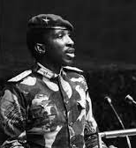
“NOBODY WILL BE SURPRISED TO HEAR US ASSOCIATE THE FORMER UPPER VOLTA, NOW BURKINA FASO, WITH THAT DESPISED RAG-BAG, THE THIRD WORLD, WHICH THE OTHER WORLDS INVENTED AT THE TIME OF OUR INDEPENDENCE IN ORDER BETTER TO ENSURE OUR INTELLECTUAL, CULTURAL, ECONOMIC AND POLITICAL ALIENATION”

Slide 34
“THE DEBT CAN'T BE REPAID IN THE FIRST PLACE BECAUSE IF WE DON'T REPAY IT, THE LENDERS WON'T DIE. THIS IS TRUE. BUT IF WE REPAY, WE WILL BE THE ONES WHO DIE.“
"WE CAN'T REPAY BECAUSE WE DON'T HAVE THE MEANS TO DO SO. WE CAN'T PAY BECAUSE WE'RE NOT RESPONSIBLE FOR THIS DEBT."

Slide 35
“THEY MUST PROVIDE A FAITHFUL PICTURE FOR THEIR OWN PEOPLES, A PICTURE THAT WILL ENABLE THEM TO CARRY OUT PROFOUND CHANGES IN THE SOCIAL AND POLITICAL SITUATION SO THAT WE CAN FREE OURSELVES FROM THE FOREIGN DOMINATION AND EXPLOITATION THAT CAN LEAD OUR STATES ONLY TO FAILURE.”

Slide 36
“HERE I AM BUT THE HUMBLE SPOKESPERSON FOR A PEOPLE WHO REFUSE TO WATCH THEMSELVES DIE FROM PASSIVELY WITNESSING THE DEATH OF THEIR NATURAL ENVIRONMENT. SINCE AUGUST 4, 1983, WATER, TREES AND THE LIFE OF THE ENVIRONMENT HAVE BEEN CONSIDERED FUNDAMENTAL AND SACRED; FOR ABOUT THREE YEARS THE PEOPLE OF MY COUNTRY HAVE BEEN FIGHTING THEIR WAR AGAINST DESERTIFICATION.
FOR ABOUT THREE YEARS IN BURKINA FASO EVERY HAPPY EVENT IS CELEBRATED BY PLANTING TREES. I WOULD LIKE TO SHARE WITH YOU THE BIRTH AND DEVELOPMENT OF A DEEP AND SINCERE LOVE BETWEEN THE BURKINABE AND TREES IN MY HOMELAND.
IT SEEMS TO US IN THIS WAY TO APPLY OUR THEORETICAL CONCEPTS TO THE SPECIFIC WAYS AND MEANS OF THE SAHELIAN REALITY, IN THE SEARCH FOR SOLUTIONS TO THE PRESENT AND FUTURE DANGERS THAT ATTACK TREES ALL OVER THE WORLD. WE WANT TO AFFIRM THAT THE STRUGGLE AGAINST THE ADVANCE OF THE DESERT IS A STRUGGLE FOR THE SEARCH OF A BALANCE BETWEEN HUMAN BEINGS, NATURE AND SOCIETY."

Slide 37
references
Greiner, A. Dematteis, G. Lanza, C. 2019. Geografia Umana. 3° edition. Edited by Vanolo, A. Novara. De Agostini Scuola SpA
Nichols, R. 2020. Theft is property! Dispossession and Critical Thinking. Duke University Press
Discourse of Thomas Sankara: https://www.youtube.com/watch?v=9X5899cdlqs

Slide 38
Thank you for your attention!

