Slide 1
The female factor – gender balance in the law enforcement
Barbara Kryszyłowicz

Slide 2
Introduction
The problem of women in the modern defense forces of the country is diverse. I decided on this subject because of my personal interest in this type of work in the future. I believe that equality in this area is very important and must be paid attention to.
I will focus primarily on women in police units. I will mark their value and differences in relation to different countries. I will put special attention to describing the situation in my country.

Slide 3
FIRTS CHAPTER
The first chapter of my work is based on the introduction to the topic. I explain the various definitions needed to understand the whole topic of women in individuals, and in the context of feminism. I’m explaing the differences in extreme feminism. Also what changes should be in my opinion, and what the effects may be if this does not happen.

Slide 4
SECOND CHAPTER
The second chapter is based on the history of women in Poland. When there was a change in the women's employment system. What happened during the war and what the effects were. Then I will go to the description of reality and Poland about women in special units. I will pay special attention to the subject of police.
In the context of the example mentioned above, compare other countries to the current situation in Poland or I will describe myself in the context of approaching women in special units.

Slide 5
LAST CHAPTER
The last chapter is dedicated to the summary of my conclusions, and all experiences and feelings related to this. Will summarize whether there is something that can be changed in my opinion, and whether there is a way.

Slide 6
Through this work I would like to show the problems of modern women in special units. Make you aware that depending on the country in which you are, the view on this problem may be different. I think it is worth looking at it more broadly from the perspective of several countries and cultural differences. The work is not intended to solve the problem, but to understand the problem itself.
CONCULSION

Slide 7
WHAT inspired me on the website:
Amna Baig, an ASP with the Pakistan Police, shares her story of how she decided to change her weapon, going all the way from using a beater to make cakes to using a pistol to fight crime:
https://youtu.be/WW4Xm0Nh1C0
Chief Danielle Outlaw takes our hand and walks us down the road to reconciliation with her views on 21st century policing. Her Idea? To restore the humanity IN authority. That the Police and the community must have a trusted relationship and embrace commonalities or we will continue to remain at a crossroads:
https://www.youtube.com/watch?v=iYryJIvCXx8
"From the diary of a policewoman"
A Polish woman who decided to work in the police describes exactly every important aspect. Starting from the basic information because her opinions and experiences. Unfortuletly, this is story in Polish language
https://www.youtube.com/watch?v=2xAFawm-mKM
Interviews with policewomen from various police departments. This video showed me that women manage on various subjects: https://www.youtube.com/watch?v=hCiID2Tp0wE

Slide 8
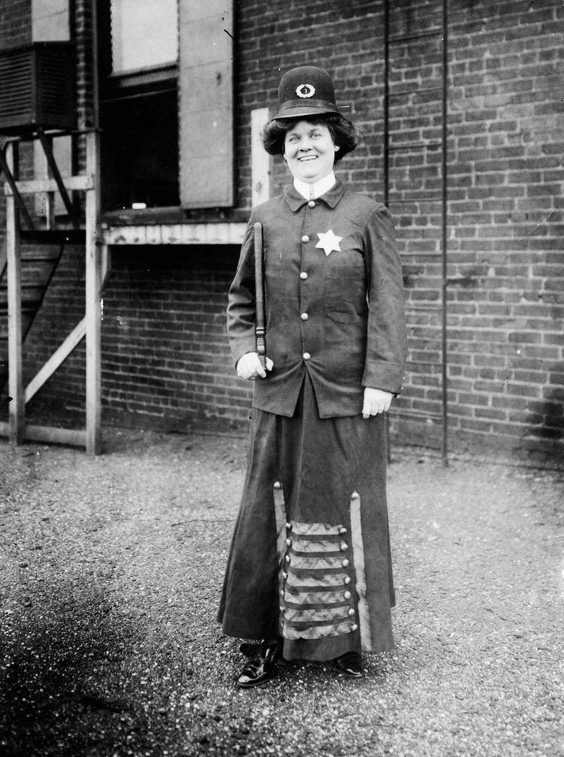
The woman who inspired me to choose this topic is Alice Stebbins Wells
(born June 13, 1873) American minister and social welfare worker who, in 1910, became the first woman appointed to the Los Angeles Police Department. Although Stebbins was not the first female police officer in the United States, she is believed to have been the first to hold powers of arrest.

Slide 9
Thank you for attention ☺

