Slide 1
Empowerment for who?
The gender perspective in International aids

Slide 2
Remember that the knowledge is always SITUATED Interviews with Chandra Talpade Mohanty, Under the western eyes (1984), Feminism without Borders: Decolonizing Theory, Practicing Solidarity, 2003. https://www.youtube.com/watch?v=9EDFA-bKq1o https://www.youtube.com/watch?v=W7-EeP5AFG4

Slide 3
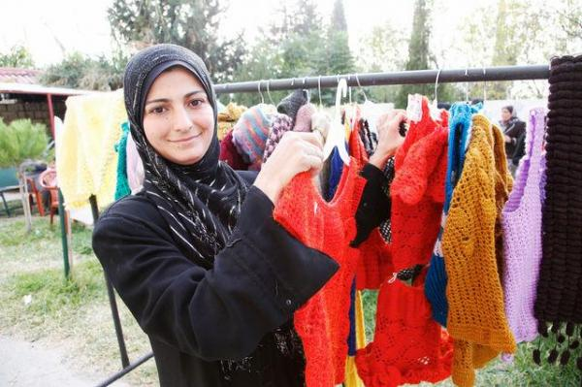
Amira Hasan, 32,
from Syria.
She used to live in a refugee camp close to Beirut
Now she lives in Baalbek, Lebanon.
She is a facilitator among the syrian community in Lebanon
My real life began five years ago when I had the chance to work in the refugee camp where I was living in the south part of Beirut, at Burl El Barajneh. Thanks to the skills I’ve learned now I’am able to positively impact my community.
My “empowerment” was to have the chance to invent and then run my own job and spend my capacities to earn my own money”.

Slide 4
There are NGOs in Lebanon that offer many programs and courses in order to educate women on their rights and work to end their illiteracy.
In asylum countries, the programs offered to Syrian refugee women often focus on protection against domestic and gender-based violence.
The organization also contributes to forming local councils with female leaders.
The role of the NGO

Slide 5
Beyond cooking good….
Many international organizations have moved beyond the cooking, the handicrafting and cosmetology workshops that contribute only to reinforce stereotypes about traditional female roles in society.
Organizations now want to prepare women to be leaders in their communities and help them integrate into the labor market through economic empowerment and community leadership programs.

Slide 6
BUT
Is the empowerment
– as we intend it in western countries-
really useful (and viable!)
for refugees women today?

Slide 7
Political empowerment (for us)
In generic terms, empowerment is closely linked to economic and social independency, starting from the decision-making mechanism at home, and continuing to the right to run for public offices, companies and chose whatever field of study and jobs.
The possibility to exercise this rights was absent for decades in Syria, a lot before the war
And absent, in a strict patriarchal society, was also the material possibility to participate in public spaces for most of the women!!!
There were no condition for exercising these rights
even before the war, due to lack of legislation….

Slide 8
holes and gaps in the action of the International community
NGO’s political empowerment programs for refugee women are not always useful in asylum countries, since many of those countries lack even the basic laws that guarantee women their rights.
The skills the Ngos bring into the community of refugees are often intended for the future…
but what kind of future? And where….

Slide 9
Lack of planning, lack of funds
The empowerment projects in most of the refugee camps lack strategic planning nor they meet the real needs of the refugees.
The communication between the participants and the organizing entities is limited to the workshops, which only last for two to three days, there is no follow-up with the participants after the workshops in order to help them to put into practice what they have learnt.
Additionally, these programs usually do not allocate specific funds to provide legal assistance for the refugee to find a real integration or at least a work permission within the host country…
Everything is intended «for the future i ntheir home countries», but nothing for an immedate help in the host countries…

Slide 10
Although cooking means reinforcing stereotypes, maybe there are many different ways of doing it…
https://www.youtube.com/watch?v=hX-OMq4oTRI

Slide 11
The Soufra project
Soufra follows the unlikely and wildly inspirational story of intrepid social entrepreneur, Mariam Shaar – a generational refugee who has spent her entire life in the Burj El Barajneh refugee camp just south of Beirut, Lebanon.
The film follows Mariam as she sets out against all odds to change her fate by launching a successful catering company, “Soufra,” and then expand it into a food truck business with a diverse team of fellow refugee woman who now share this camp as their home.

Slide 12
https://www.soufrafilm.com/trailer
https://www.youtube.com/watch?v=73-UNCtBNpY&t=10s

Slide 13
Holes and gaps in the action of the international community
Another big problem linked to the western type of “empowerment” is that the international organizations tend to remove MEN from the new knowledge of rights and equality (the philosophy of the affirmative actions…) raising in this way the rate of domestic violence against refugee women in the camps

Slide 14
Another gap: the controversial role of the «testimonials»
Women are not encouraged and supported to organize themselves in civil society, in associations or parties, or cooperatives, or groups in order to find or invent a job together….
Instead of encouraging them to express their own demands, develop their skills or trying to connect them, giving them the feeling that they can make it, that they can make an be the change, in most of the case, they are “used” or “trained” to speak on their behalf in international forums ….
Which is fine, of course, but becoming a testimonial of a tragedy is not enough…

Slide 15
They need a different type of empowerment
Workshops and training on how to become able to participate in political debates are good, but not useful!!! Removing stereotypes from the knowledge we want ot give them is fine, but we have to understand that dealing with a differnt culture is adelicate issue… we havethe best interntion, but we can produce harm to someone, with our best intentions!!
For most of the people, political participation is linked to "opposing the Syrian regime," which makes many fearful of participating in political empowerment workshops that might anger the Syrian regime and therefore impact their family still living in Syria.
Syrian women refugees consider economic empowerment a GREATER PRIORITY than political empowerment, then the removal of stereotypes linked to their role in society!!!

Slide 16
NGOs work in a very difficult environment
Participating in any kind of worksops able to transfer knowledge to them is in any case very useful for refugee women.
Participating in the Ngos workshops, provide the a certificate that allow them to receive a transportation allowance that can provide an income of up to $4 a day.
BUT
The problem is that, as soon as these workshops end, women receive no further support.
WHILE
If they are able to make a product or a handicraft, for example, they do not receive help marketing and selling their products.
It’s like a snake who bites his tail

Slide 17
Workshops ends- help ends
In most of the NGOs’ programs, support ends with the end of the program itself, either due to a shortage of funding or the relocation of participants.
Despite these programs' goals to empower women, most of them fail to provide sustainable support to help women actively engage in the public domain.
They need literacy and practical skills in a continuative way

Slide 18
Impossible to apply their skills in the host countries
It is true that it is important to prepare women to engage in the process of decision-making, and to refine their leadership skills so they can contribute to changing society and to the peacemaking process at the local and international levels,
But Syrian refugees in Lebanon and Jordan often face difficulties in applying their newly obtained political and decision-making skills due to these countries' positions on the conflict in Syria.

Slide 19
Read the context!
One workshop cannot make a significant difference in the lives of women, especially when the organizations providing the workshops offer no ongoing support.
The cannot apply political skills but they should be able to apply their practical skills if they had some!

Slide 20
Our stereotypes are not their stereotypes
Giving women practical skills - embroidering, sewing, cooking, cleaning,
does not necessarily reinforce stereotypes of the traditional role of women.
In context like these, things like sewing allows women to develop their creativity.
"I studied economics in college," says Amira, "When I arrived in Jordan in 2012, I worked at a clothing factory. Although it is not related to my education, I enjoy my work, and it provides me with a reasonable income."

Slide 21
Top down or/and bottom up
In context like these – the camp, as well as the future Syria, a country devastated now, but with no laws of equality even before the crisis- the bottom up action - the EMPOWERMENT as we intend it- is not useful, or at least it is not the most useful approach ….
What they need most are education, competences for developing their oun skills (Bottom-up approach ) but also a TOP down action to implment a system of laws and a constitution inspired by non discrimination principles.

Slide 22
And… and what about women and the people in general who are still in Syria? Is someone taking care of them, of their skills, of their empowerment? The cannot stay out of the process of change!!!!!!

Slide 23
The city of the new millenium: Zaa’tari camp in Jordan
Population: 80.000 people

Slide 26
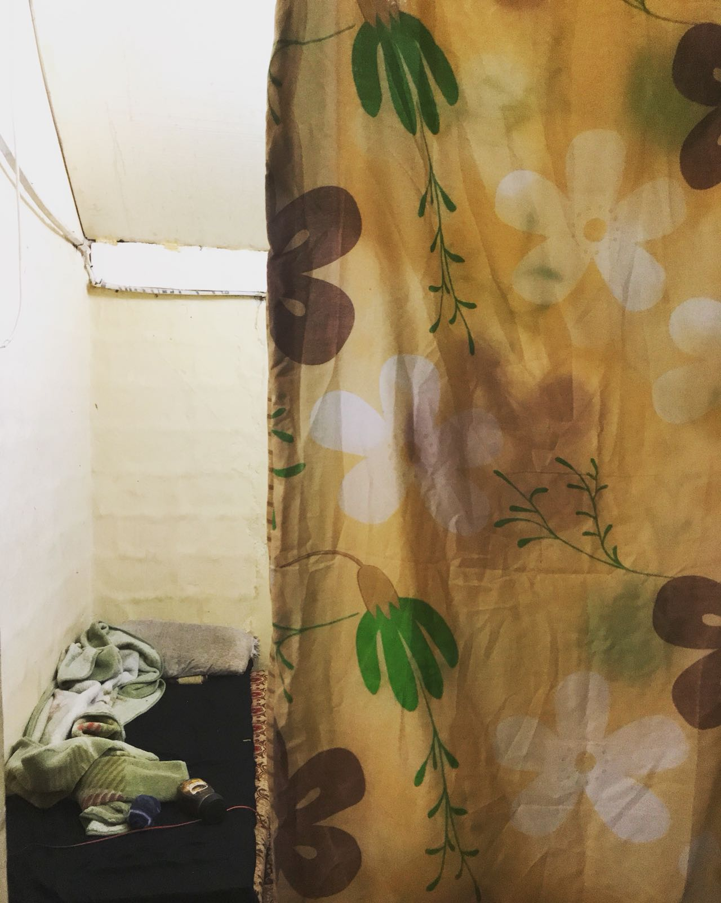

Slide 30
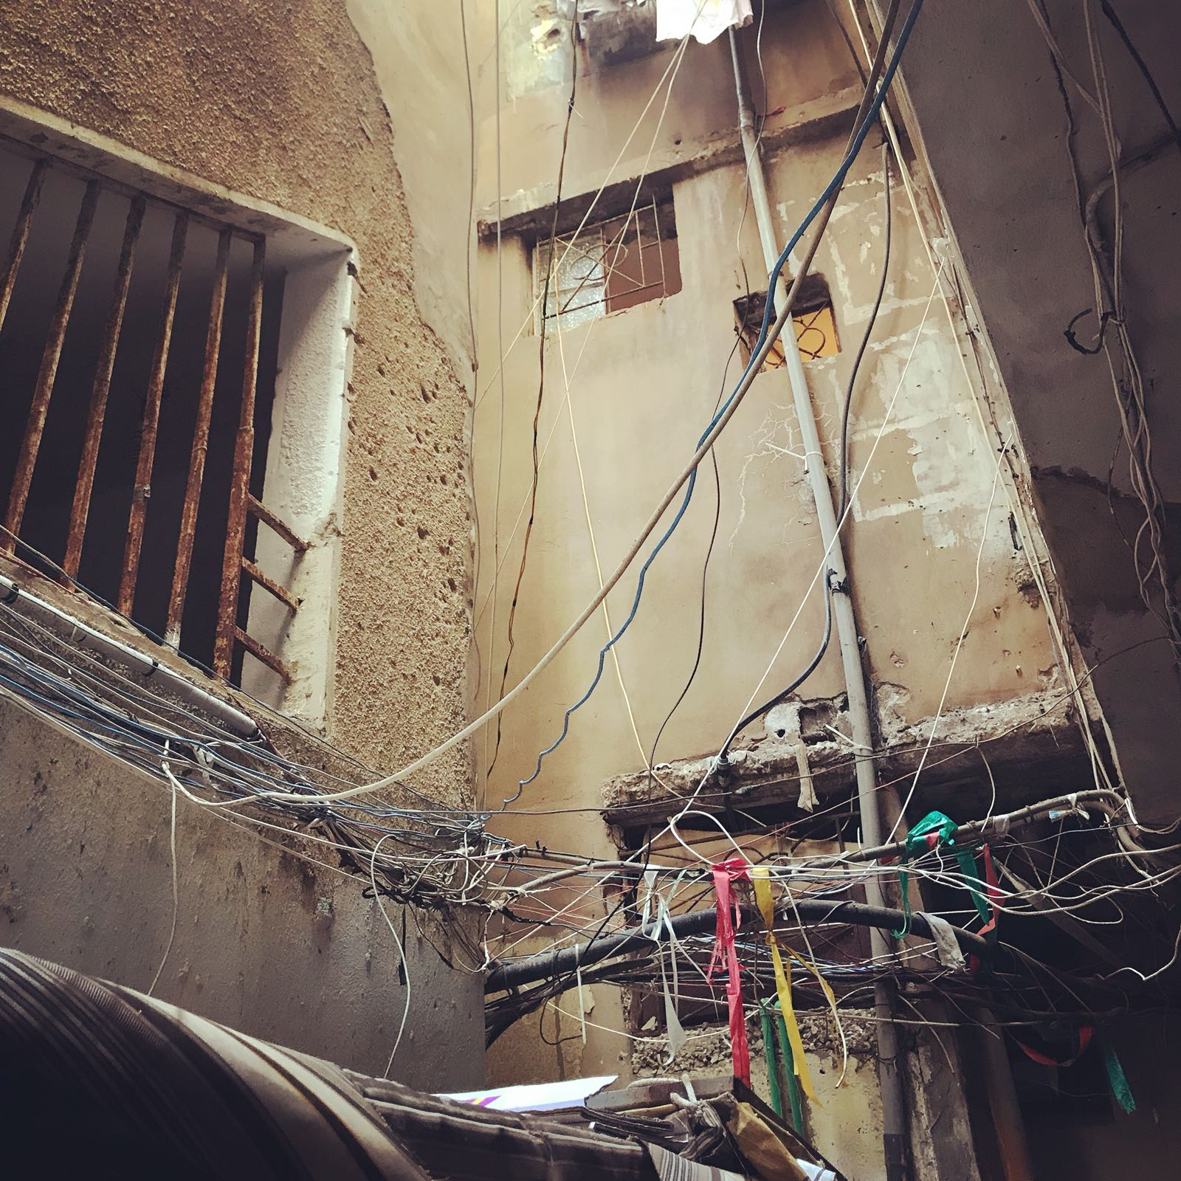

Slide 31
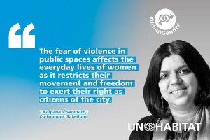
Women are the «forgotten one» (even in the refugee camps)
Gender inequalities persist and women and girls benefit less from urbanization and urban spaces than men and boys.
In fact, women and girls in cities will face a range of specific barriers and vulnerabilities in the form of gender based discrimination:
gender inequality, violence against women, poverty, unpaid care-work, limited control over assets, unequal participation in public and private decision-making; as well as, barriers to education, employment, housing and basic services.

