Slide 1
The nation: an imagined community by Javier Sanjines – a source analysis
Presented by Zuzanna Krakowska
EPQ0090199 - DECOLONIAL STRATEGIES

Slide 2
Javier Sanjines
Born 1948
Bolivian
associate professor of Latin American literature and cultural studies at the University of Michigan

Slide 3
Introduction
Third World nations
An outdated, Eurocentric term
Derived from a colonialist mindset
Under Developed nations
More modern?
What does development mean?
Colonialist

Slide 4
Positivist ideology and a Social Utopia
Social Utopia
Socialist or capitalist
The ultimate goal of a society
Imposed by the Western ideologies
Positivism
Philosophical movement in which everything is based on logic, facts, science and mathematics
Devoid of the human element
Urban > rural
Eurocentric approach

Slide 5
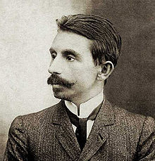
Backlash and da Cunha
Backlash to the modernization
Re-discovery of traditional Hispanic values
Rejection of the utilitarian materialism
Euclides da Cunha
Brazillian journalist
Reporting on the Canudos Rebellion
Doubts against the positivist liberalism
Destruction of the people’s identity
Imposing the Western culture and erasing the pre-existing ones

Slide 6
‘The fact that these cultures did not coexist in harmony, flourishing reciprocally, also helps explain the inexistence of a ‘national culture’. On the contrary, there was never any convergence, only opposition between the ancestral cultures and the successive variants of Western civilization that had acquired hegemony among the dominant groups’
Javier Sanjines

Slide 7
Creating a nation
Two different Brazils
Traditional and Western
Two opposing proposals for the Brazilian nation
Unable to coexist
Different understanding what it means to be human
Elimination an unification
Nation and nationalism
Terms borrowed from the Western culture
Sanjines rejects the idea of fraternal and horizontal camaraderie
Discrimination of classes

Slide 8
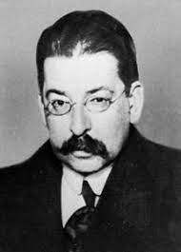
Arielism
Ariel
Written in 1900
By Jose Enrique Rodo
Contrasting two forms of society
Ariel and Caliban
Anti-imperialism
Clash with the Westernization from the US

Slide 9
Conclusion
Ultimate social utopia being capitalism
The change in understanding society and nation needed in order to reimagine it as socialism
Abandonment of the theories of modernity and postcolonialism
Re-conceptualization through subalternity
Subalternity as historical agency
The limitations of the temporality of Western history

Slide 10
Source analysed
Sanjinés, J., 2007. The nation: an imagined community?. Cultural studies, 21(2-3), pp.295-308.

