Slide 1
The importance of
recognizing (and fight against!)
stereotypes
in the digital era

Slide 2
The issue of
stereotypes is a very crucial one, because its roots
are deeply embedded in the history, culture,
education and psychology of individuals.

Slide 3
surrounded by stereotypes!
Stereotypes are
shared social beliefs,
values and norms
which reflect the roles assigned
to men and women
by a certain culture.
They are the product of specific historical,
cultural and social contexts

Slide 4
Stereotypes in threatening situation
Stereotypes are often used to maintain control and power over group of people (women, lgbt, black, muslims….)

Slide 5
Origin of the word
In 1922 the journalist W. Lippmann used the word in his book Public opinion, (New York, Free
Press, 1965) when referring to
the processes involved in forming public opinion (= OPINION OF THE SOCIETY).
Today the cognitive nexus with reality is not always based on direct individual experience, but they are mostly a common sense belief, something “taken for granted”, not validated, an image repeated again and again

Slide 6
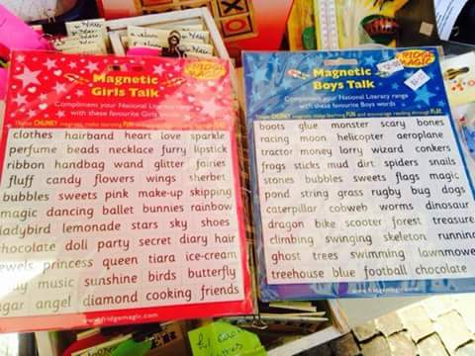
common sense difficult to wipe out
Attacking and changing the” common sense” that is the repository of gender stereotypes is not a linear process, we are never sure to succeed in this!!!!

Slide 7
A stereotype is forever
Young children need stereotypes to build cognitive maps and orient themselves into the world.
Stereotypes are part of our way of dealing with our perception of things happening around us, and hence we have to deal with them.
Nowadays, increased experience and greater information on cultural diversities can lead to more flexible categorizations that can be challenged, but sill a lot of our knowledge remain in the cage of the stereotypes. The are all over!

Slide 8
A sea full of stereotypes
Our duty is to recognize and then deconstruct stereotypes that we are producing through language, produced around us by and through the media,
being very well aware that we swim in a sea full of stereotypes, that they are all around us and they are the easiest and faster vehicle of knowledge of the world among the human beings.

Slide 9
Unwanted semplifications
Stereotypes provide simplified images of reality that help us understand and communicate, but
they also operate striking simplifications that may transcend even the real intentions of the speakers.

Slide 10
Un on the elimination of stereotypes, 2014
Eu motion for the elination of gener stereotypes (2012)
https://eige.europa.eu/gender-stereotypes
https://www.ohchr.org/documents/issues/women/wrgs/onepagers/gender_stereotyping.pdf

Slide 11
The sex of the brain
Does the brain have a sex?
TEDxParis 2011 - Catherine Vidal
https://www.youtube.com/watch?v=OgM4um9Vvb8

Slide 12
ACT like a girl using «like a girl» as an insult
https://www.youtube.com/watch?v=XjJQBjWYDTs

Slide 13
Stereotypes as social construction
It is important to recognize stereotypes in order to show that
our identity IS NOT A GIVEN ATTRIBUTE, but rather an HISTORICAL construction politically situated in the social interactions.
That’s why it always changes, evolves, moves.

Slide 14
I say no
to mass-media tyranny of attractiveness
where I only exist if I am pretty or toothsome
trading in my brain for a meagre
visibility.
I say no
to being a mere body.
To be watched
touched
judged
traded.
I say no
since I know
how this pledding of my flesh
moulds unwitting eyes.
I say no
and I demand respect
and that room be made for all my diversity
My revolution start from my rejection
of the image thrust upon us
to turn into a breathing of a newfound dignity.
“I say no to stereotypes”
(from the site Vita da streghe,
for a different kind of communication, Italy)

Slide 15
for a different kind of communication give value to differences!!!
We promote
DIFFERENCE of bodies IN the EQUALITY of rights.
There is not only one type of woman
as there is not only one type of man.
Jill Killbourne, killing us softly, complete video https://www.youtube.com/watch?v=MQ3ESVKighs
Short trailer
https://www.youtube.com/watch?v=Uy8yLaoWybk

Slide 16
Traps are not hidden only in a naked body…

Slide 17
She can’t speak, and she seems HAPPY for her new loundry cleaner…
The message is «Make loundry is cool»

Slide 18
Analisi:
Non categorizzate
She is happy in a domestic
Environment (looking like
a tecno-scientific lab…)
(are we sure?)
Donna nel suo dominio è felice, presenza anche della figlia, tende ad avvalorare ciò che Goffman affermava sul ruolo d'ausilio domestico delle figlie femmine.

Slide 19
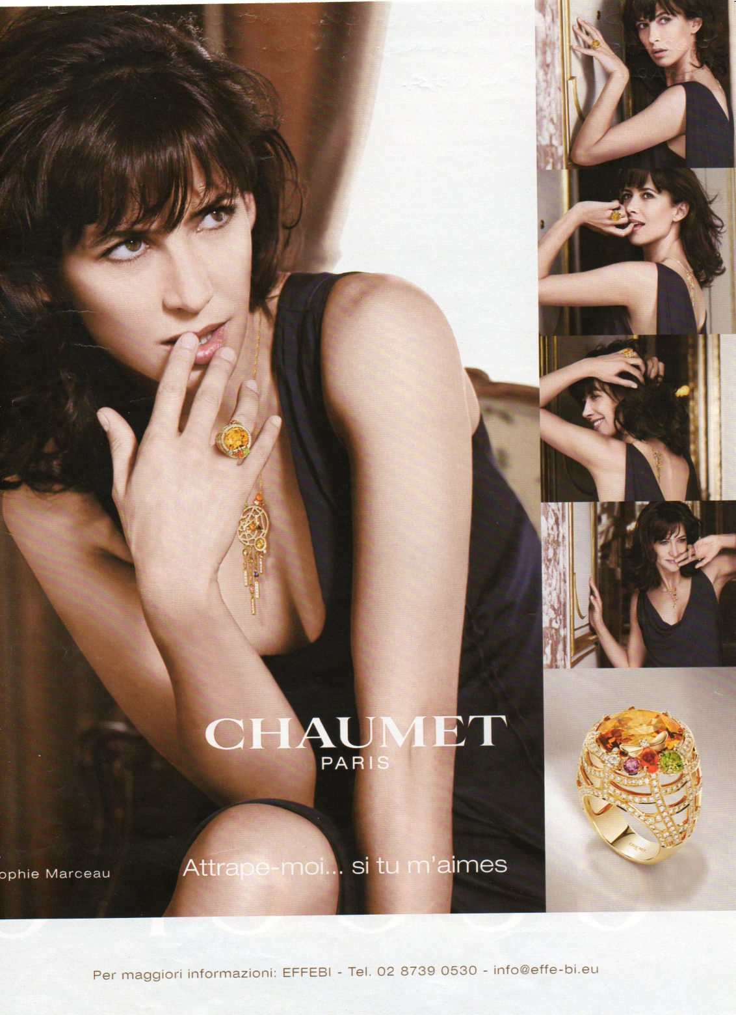
Explicit gesture
of hands and mouth
(Goffman ,1979)

Slide 20
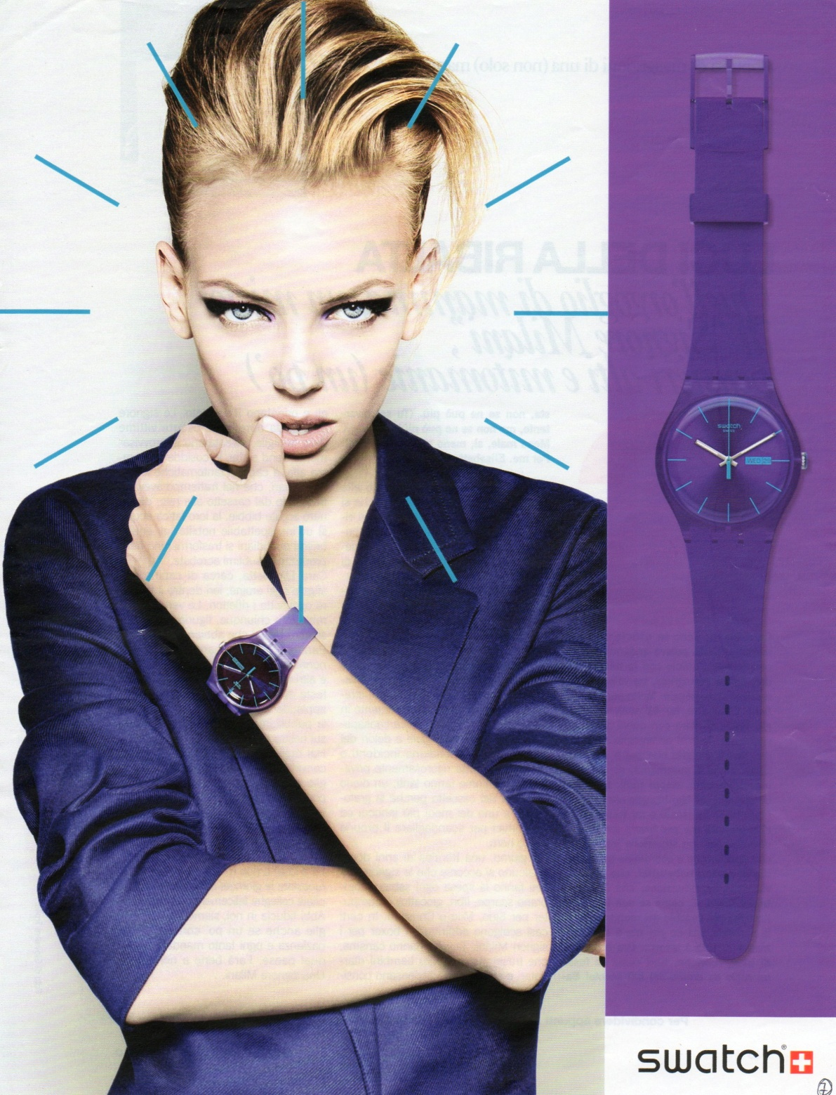
Explicit gesture
of hands and mouth
(Goffman ,1979)

Slide 21
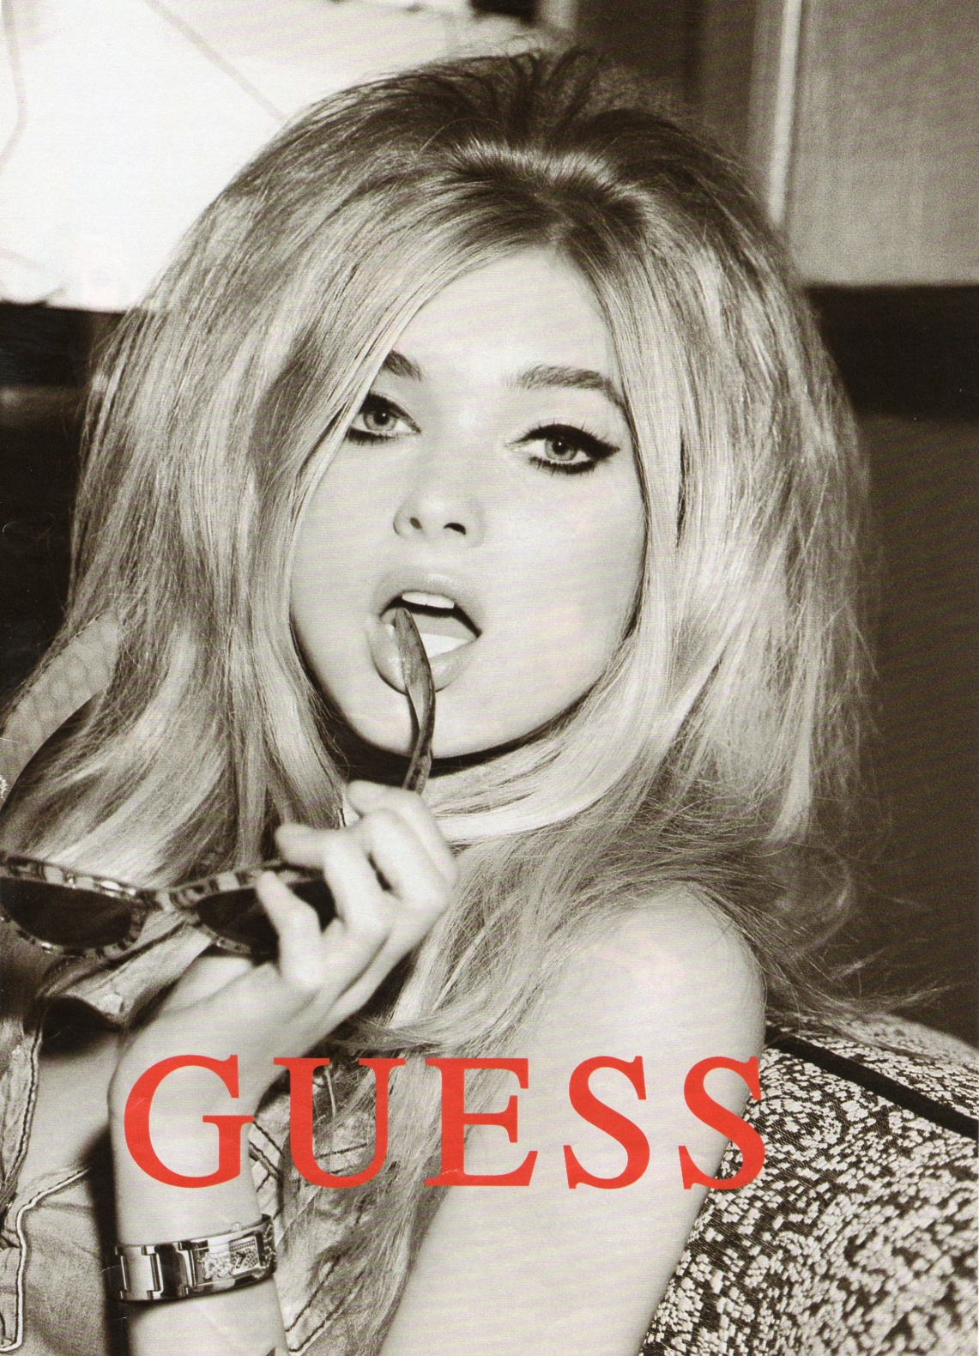
Explicit gesture
of hands and mouth
(Goffman ,1979)

Slide 22
“be the change you want to see”
Thanks!
Lorenza Perini

