Slide 1
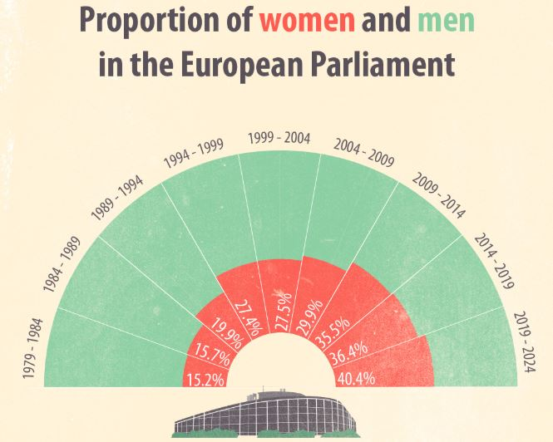
International organisms and EU institutions: interpreting gender equality part 1
Lorenza Perini

Slide 2
more or less until 1970’s: PROBLEM OF CITIZENSHIP FOR WOMEN
As we have seen, analyzing the concept of the citizenship of rights (Marshall and beyond),
women had no juridical personality in most of the countries of the World until the end of the II World War (1945) and in some cases and for certain type of rights, even beyond, up to the senventies.
National legal frameworks were born well before that dates: this means that most of the national and international institutions were born without considersing women and , at best, considering the individual a neutral entity

Slide 3
the problem still persist, not only for women…
Today, sixty years after the treaty of Rome (1957) European citizens are still very far from enjoying the same rights and a real condition of equality (remember the example of the abortion: women are in different condition within Eu).
Widening the perspective toward the LGBTQIA+ people, their citizenship of rights in particular is deeply incomplete, since they experience every day the violation and the abuse of their rights almost everywhere throughout the European countries, not to mention the rest of the world…

Slide 4
Eu gender equality margins and borders
What kind of concepts of gender- race - class - sex – sexual orientation- age,
(remember the categories of the intersectionality mentioned by Cranshow….)
the EU and international institutions show?
Narrow or broaden?
Rigid of flexible?
Universal or plural?
Binary or open to different choices?
The language they use is very important, but it reflect the historical time…

Slide 5
Back to chronology
Again, chronology and an historical perspective are important standing points to understand where we are now, the progress we have made, despite a lot of obstacles along the path, and what is still to be achieved in term of real and effective «equality for all»

Slide 6
1945 United Nation Conference of San Francisco
the first recognition of SEX DISCRIMINATION as a main problem
The strategy of the international institutions against discrimination started right after the IIWWar,
In the DECLARATION of San Francisco (the milestone of the United Nations)in the art.1 is dedicated to the principle of “prohibition of sex discrimination” ( now evolved into “respect for human rights without distinction of sex, race and religion” - although “without discrimination” would have been better than “without distinction”….. but we were in the 1945…
Always remember the timeline!!!!!

Slide 7
The EU has been thinking about «equality (intended as between men and women)» since its beginning….
STRATEGY 2030

Slide 8
1957 CONCERN ON GENDER PAY GAP/equal ACCESS TO JOB market
Treaty of Rome in 1957: the first concern of the EEC (European Economic Community) regarding the problem of equality between men and women was about “equal pay for equal work”, i.e. specific attention to the economic aspect of the problem.
But this is only one of the various types of discrimination among sexes that the society faced fifty years ago and is still facing nowadays….
The persisting discrimination in wages and in access to job and career opportunities for the mere reason of sex is still affecting women today, increasing their risk of poverty.
What we can observe now in 2022 is that, insisting on this has not produced great results so far…. Maybe because discrimination it is not a mere economic problem….

Slide 9
From Rome 1957 to Maastricht1992
The Member States of the EU consider the issue of the equality policies in art. 119 (now 141) of the 1957 Treaty of Rome recommending equal pay for men and women.
BUT HOW??????
We have to wait until 1992 to have an official indication of a tool to use to try to reach equality: the affirmative ACTIONS (recommending to take gender into account in establishing the criteria for employment, promotions, and participation in decision-making institutions (and favoring, in cases of equal merit, a woman over a man)
(which is not a perfect tool anyway… a lot of opposition because they can be seen as “discriminations against men”… or just because the hidden meaning is that women are lacking something, they need special help to be equal to men… )
Anyway, with the Maastricht Treaty in 1992 we see a development of the SOCIAL POLICIES’ FRAME (not just words but instruments, policies, tools to foster equality and a special consideration for SOCIETY, for the people, not just for the economic aspects)

Slide 10
1979 CEDAW: Against violence and discrimination against women
the international institution Convention/Conference for Eliminating Discriminaton Against Women (CEDAW) defines DISCRIMINATION against women as:
“any distinction, exclusion, or restriction, made on the basis of sex, with the purpose or effect of impairing the enjoyment by women of political, economic, social, cultural, or civil human rights on equal footing with men”.

Slide 11
CEDAW: the International and Super-national framework:
The CEDAW constitutes the most important international instrument for women's rights.
CEDAW was created in order to bring “the female half of humanity into the focus of human rights concerns because – despite the existence of other instruments – women still did (and do) not enjoy equal rights with men”
Remember what we said about the claim that “women rights are human rights”… here is the origin!

Slide 12
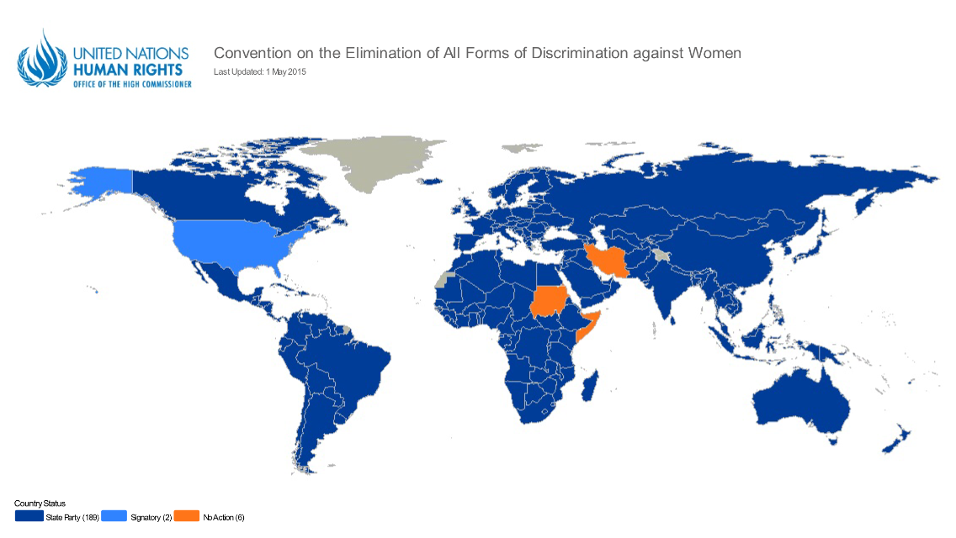
Many countries signed the decalration… but-….
http://indicators.ohchr.org/
USA signed the treaty in 1980 but they had never ratified it
!!!
Middle east countries:
THE FALSE
POSITIVE the signed but only some articles
NO action
at tall

Slide 13
CEDAW: The possibility of reservations
As in many other cases, with CEDAW the ratification is not the end of the story !
Country can sign just some articles and withdraw the rest of the treaty!!
In the Middle East region, some countries’ legal system is based solely on Islamic Sharia law.
The most common general reservation made by these countries is that accession to the CEDAW cannot conflict with Islamic Sharia and the national legislation.
They withdraw the clauses in which discrimination due to religion is mentioned!!!!!

Slide 14
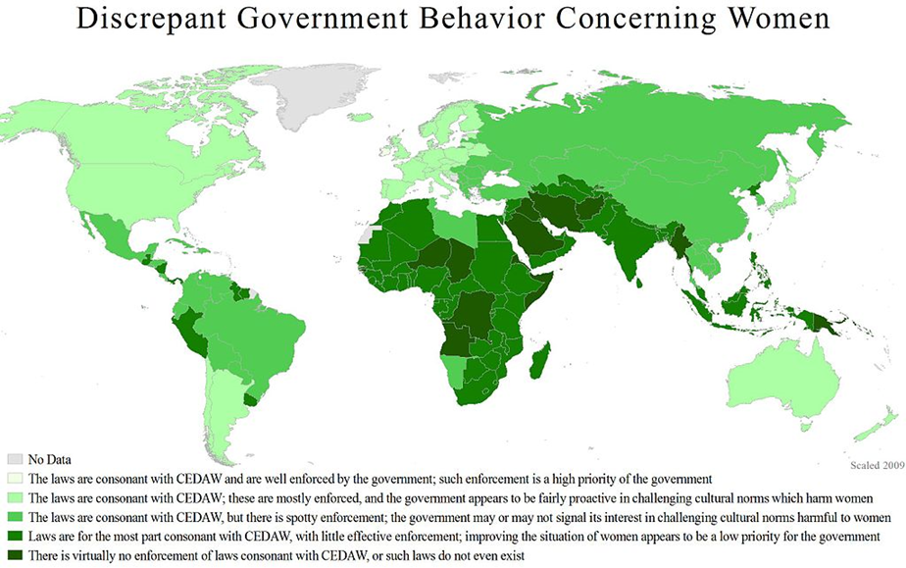

Slide 15
A different type of tool Bottom-up approach: Civil society and NGOs – the shadow reports
NGOs can submit information which can be added to the “other stakeholders”
Essential role
→ Committee receives information from NGOs, which may attend the open meetings of the Committee, where they engage in a constructive dialogue with States parties presenting “shadow reports” to the Committee where they draw attention to gaps in implementation or flagrant abuses of rights by the state.
→ UPR monitoring mechanism, NGOs can submit information which can be referred to by any of the States taking part in the interactive discussion during the review, helps the personnel to draft the compilation

Slide 16
From Maastricht to Amsterdam (1992-1997): definition of GENDER MAINSTRAMING
Since the ratification of the Maastricht Treaty, several directives have been adopted in this area, and in 1997 the Amsterdam Treaty strengthened the legal basis for equality between men and women even more.
GENDER MAINSTREAMING
In particular, art. 2 and 3 state that the Community is committed to promoting GENDER MAINSTREAMING, which means that the principle of equal opportunities must be integrated into all Community policies.
AGAIN: HOW??????

Slide 17
UN Women Conference Bejing, 1995
Another important date for the rights of women is 1995 because the IV World Conference on Women took place in Beijing.
If the Convention on the Elimination of All Forms of Discrimination Against Women (CEDAW) is the main legally binding text on women's rights,
the Platform of Action adopted by the Beijing Conference is the most important political text and is even more interesting for women worldwide.

Slide 18
Bejijng approach: Positive actions are not enough
The Beijing Conference was the fourth in a series of world conferences on women organized by the United Nations since 1975 and represented the culmination of a long preparatory process, at international and regional levels.
Important statement: in order to fight the existing structural inequalities, acting only through positive action does not seem to be enough, but requires a comprehensive approach in order to affect the roots of these discriminations (top down/bottom up simultaneously).
But again: HOW????

Slide 19
Bejing women conference, 1995
The website of the conference
http://www.un.org/womenwatch/daw/beijing/platform/
The platform and the final document
http://www.un.org/womenwatch/daw/beijing/pdf/BDPfA%20E.pdf

Slide 20
Mainstreaming as a key word
Since Beijing 1995, the concept of mainstreaming (gender perspective in all politics and policies) has been theorized and systematized, the integration of gender perspective in all policies has become the subject of numerous debates in supra-national organizations as well as in local governments, and during the time that has led the European Union to include 27 countries, the concept of gender equality has been repeatedly reaffirmed, gradually consolidating the idea of integrating the goal of equal opportunity into all Community policies as stated by the 1996 communication of the EU.
Again the question is HOW??????

Slide 21
Charter of Rome 1996: mainstreaming as the essence of eu citizenship….
In 1996, the “Carta di Roma” was finally subscribed by the ministers of 13 of the European States in a conference called “Women for Renewal of Politics and Society”.
The “Charter” stated that the principle of mainstreaming should be the essence of European citizenship from that time on, in order to prompt the EU into making a declaration upon the topic of the under-representation of women at all levels of social and political life.
However, the declaration formula - the “Carta- was too weak an instrument to compel the States to make a move, so nothing really changed after that.

Slide 22
1998: IULA on women in politics
In 1998 the IULA- International Union of Local Authorities- in order to push each single local government into adopting a gender point of view in the production and application of its policies (bottom up approach), declared that:
"... The local government is in a privileged position to contribute to equality of the sexes. As the level of governance closest to citizens, service providers, employers, it may have a strong impact on the status of women and on the situation of gender equality in the world .... "
so now they say who is in charge to foster equality and anti discrimination policies but
they still not saying nothing about HOW?????

Slide 23
so what are the tools in the hands of the Eu and international institutions?
Can the EU impose to the member states specific measures to fight discrimination?
Can Eu impose changes in local legislations?
NO
The only way to guarantee the resepct of the non discrimination policies is to introduce a particular attention to this problem into national legislations, that are usually born for and by neutral citizens.
In order to do this, the instruments of the EU and international institutions are:
Reccomendations,
Treaties
Directives
Resolutions
Roadmaps
Strateiges
Among these only directives are mandatory for the member states…

